Slide 1
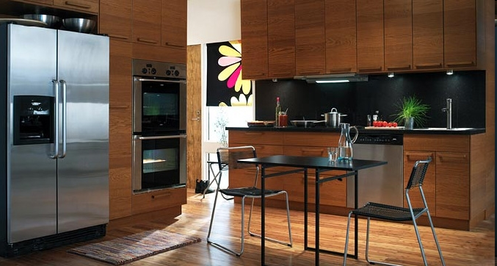
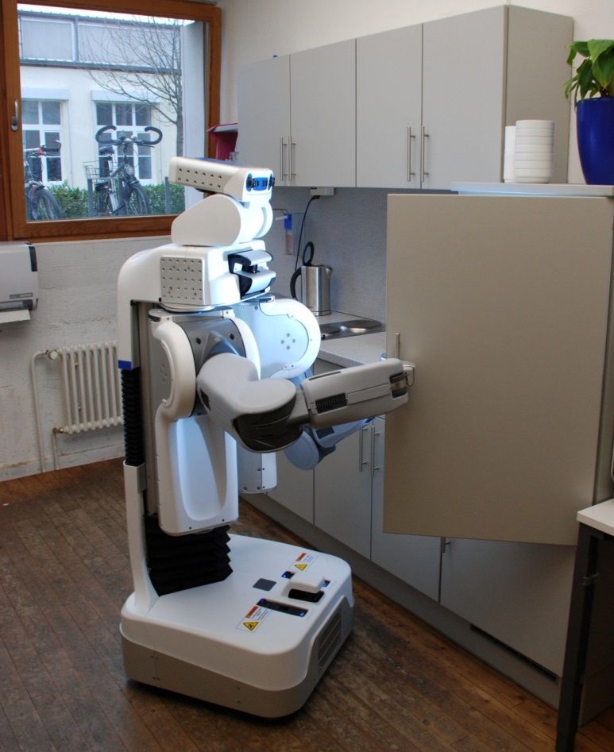
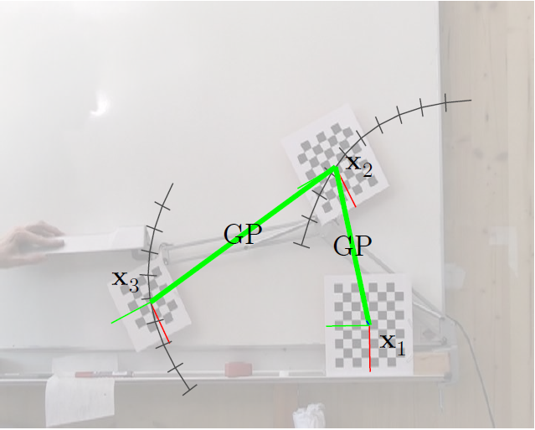
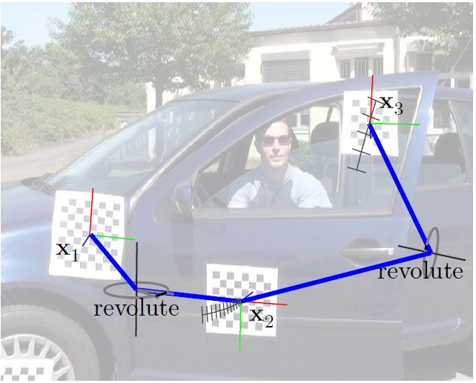
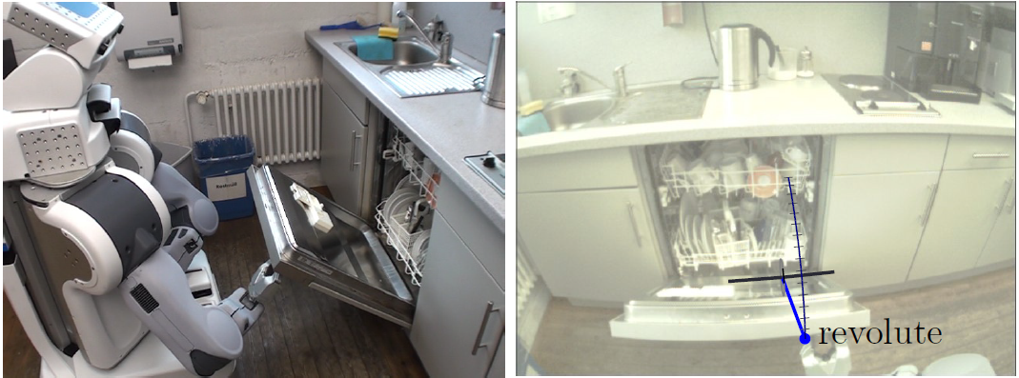
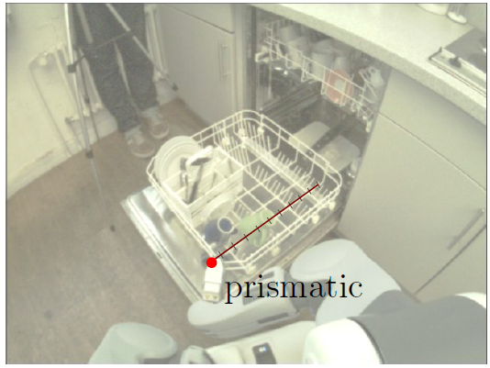
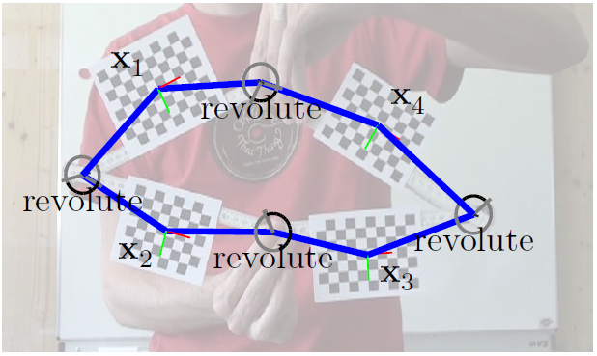
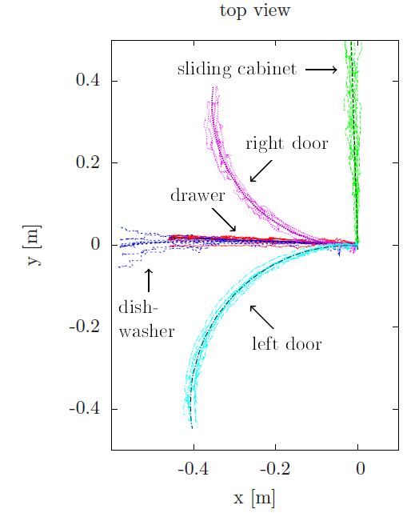
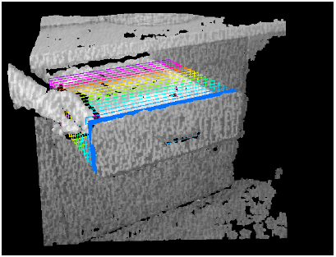
ECCAI Artificial Intelligence Dissertation Award:
Learning Probabilistic Models for Mobile Manipulation Robots
Jürgen Sturm and Wolfram Burgard, University of Freiburg, Germany
Talk today at 15:45
Room 201CD
Motivation
Domestic service robots need the capability to deal with articulated objects such as:
Cabinets
Doors
Drawers
Dishwasher
Windows
Fridge
…
How can we model such objects? How the a robot learn to operate such objects?
Problem Statement
Given a sequence of 3D pose observations
Estimate the most likely model and parameter vector
Approach
Bayesian inference in two steps
Model fitting
Model selection
Model Fitting Using MLESAC on a set of candidate models
Rigid model
Prismatic (linear) model
Revolute (rotational) model
Gaussian process model
Each candidate model implies a (inverse) kinematic function
Inference: Maximize data likelihood
Model Selection
We need to compare the posterior probabilities
Approximate integral using the Bayesian Information Criterion (BIC)
Finding the Topology
Arrange objects in a graph
Edges represent potential models
Assign costs to each model corresponding to BIC
Algorithm
Start with fully connected graph
Find best kinematic tree
Solve with spanning tree algorithm
Results
Explored Extensions:
Dealing with kinematic loops
Interactive learning
Learning priors
Vision-based perception
Further topics in PhD thesis: Body schema learning, tactile object recognition, imitation learning
data likelihood
model complexity penalty
Non-parametric regression
using Gaussian Processes (GP)
parametric
3D pose
observations
latent configurations
non-parametric
Non-linear dimensionality reduction
using locally linear embededing (LLE)
J. Sturm: Approaches to Probabilistic Model Learning for Mobile Manipulation Robots, Springer Tracts in Advanced Robotics (STAR series), Volume 89, 2013 PDF, software, and videos available online: http://vision.in.tum.de/members/sturmju/phd_thesis

