Slide 1
Autonomous Navigation for Flying Robots Lecture 7.2: Visual Odometry
Jürgen Sturm
Technische Universität München

Slide 2
Cascaded Control
Robot
Trajectory
0.1 Hz
Visual Localization
Position Control
10 Hz
Attitude Estimation
Attitude Control
1 KHz
RPM Estimation
Motor Speed Control
10 .000 RPM
Sensors
Actuators
Quadrotor Physical World
Kinematics
Dynamics

Slide 3
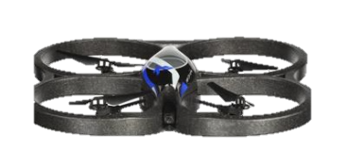
Visual Odometry
Velocity estimates from IMU are very inaccurate
(How) can we get more accurate velocity estimates?
Real-time and minimal delay
H
H

Slide 4
Visual Odometry
Idea:
Track the motion of one or more points in the camera image
Estimate 3D motion from this
H
H

Slide 5
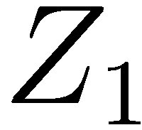
Scale Ambiguity
Purely from monocular vision, it is not possible to determine the absolute speed

Slide 6
Scale Ambiguity
Purely from monocular vision, it is not possible to determine the absolute speed
Insight: We need additional sensors

Slide 7
Visual Odometry
Typical sensor combination for visual odometry on UAVs:
IMU (provides absolute orientation)
Height sensor (ultrasound)
Downlooking camera
Furthermore, we assume a planar floor.

Slide 8
2D Translation
Assume that we look perpendicular onto the planar ground
Assume that we know the height Z (from ultrasound)
Assume that we observe a 2D motion of
What is the corresponding motion in 3D?

Slide 9
2D Translation
Assume that we look perpendicular onto the planar ground
Assume that we know the height Z (from ultrasound)
Assume that we observe a 2D motion of
What is the corresponding motion in 3D?
Notes:
x is the observed pixel location of the tracked point in the second image; p is the 3D point in the frame of the second camera

Slide 10
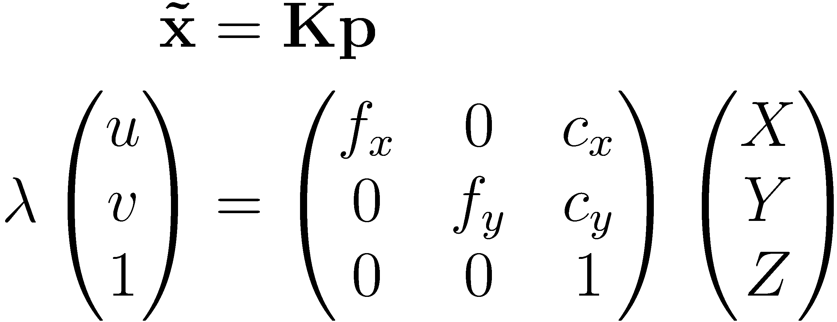
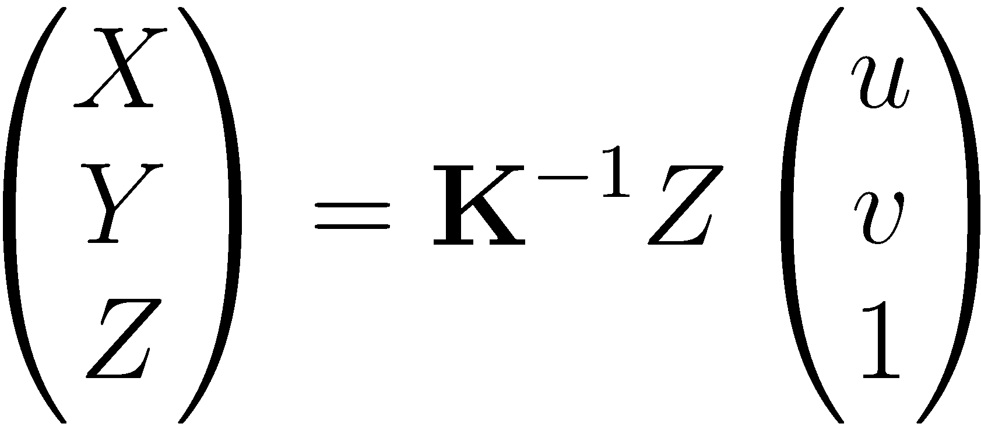
2D Translation
3D to 2D perspective projection
Now let’s solve for p (in particular, X and Y):

Slide 11
Rotation + 2D Translation
What if the quadrotor tilts during flight?
Assume that we have an IMU that gives us the (relative) rotation R

Slide 12
Rotation + 2D Translation
What if the quadrotor tilts during flight?
Assume that we have an IMU that gives us the (relative) rotation R
Notes:
P’ is the point in the rotated camera, P is the point in the de-rotated (horizontal) camera

Slide 13
Rotation + 2D Translation
Let’s de-rotate the camera image first
Notes:
P’ is the point in the rotated camera, P is the point in the de-rotated (horizontal) camera

Slide 14
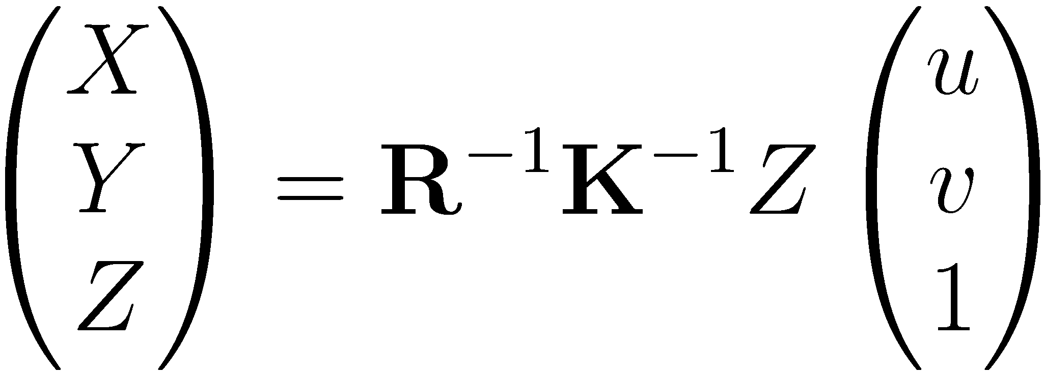
Rotation + 2D Translation
Point p appears in the de-rotated image at
Now only pure translation remains, same procedure as before
Notes:
P is the point in the rotated camera, P’ is the point in the de-rotated (horizontal) camera

Slide 15
Height Change
What if the quadrotor changes its flying height?

Slide 16
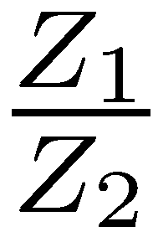
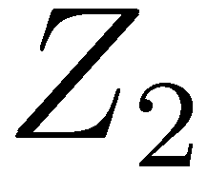
Height Change
What if the quadrotor changes its flying height?
Point remains at the same location
Pixel coordinate gets scaled by

Slide 17
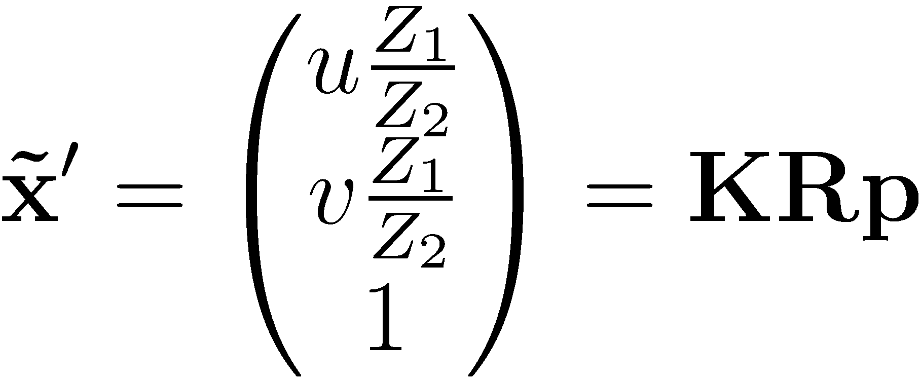
Height Change
What if the quadrotor changes its flying height?
Point remains at the same location
Pixel coordinate gets scaled by
Notes:
X’ is the pixel coordinate in the simulated camera (located at same height)

Slide 18
Increasing Robustness
So far, we tracked only a single point in the image
Motion estimate is noisy and potentially an outlier
Solution:
Track multiple points (e.g., 16)
Majority vote (RANSAC algorithm)

Slide 19
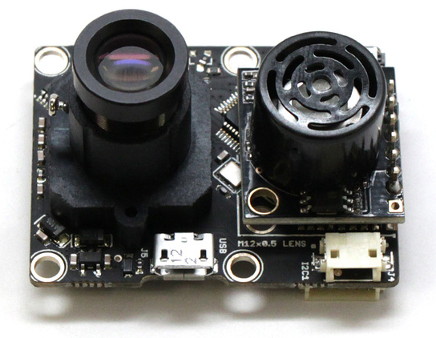
Two Examples
Parrot Mainboard + Navigation board [Bristeau, IFAC WC 2011] Camera + IMU + ultrasound + pressure, 180 USD
Pix4flow sensor from ETH [Honegger et al., ICRA 2013] Camera + IMU + ultrasound, 120 EUR
http://www.parrotshopping.com/us/p_parrot_product.aspx?i=230895
http://pixhawk.org/modules/px4flow

Slide 20
Pix4Flow Sensor [Honegger et al, ICRA 2013]
Smart camera module
752Hx480V (60fps), 188Hx120V (250fps), 16mm lens
ARM Cortex M4 (168 MHz, 192 KB RAM, single precision floating point operations)
MEMS gyroscope (L3GD20)
Ultrasound sensor
Outputs speed over serial link
Open-source

Slide 21
Demo Video [Honegger et al, ICRA 2013]
Dominik Honegger, Lorenz Meier, Petri Tanskanen and Marc Pollefeys. An Open Source and Open Hardware Embedded Metric Optical Flow CMOS Camera for Indoor and Outdoor Applications, ICRA2013.

Slide 22
Pix4flow on a Modified Ardrone [Honegger et al, ICRA 2013]
Dominik Honegger, Lorenz Meier, Petri Tanskanen and Marc Pollefeys. An Open Source and Open Hardware Embedded Metric Optical Flow CMOS Camera for Indoor and Outdoor Applications, ICRA2013.

Slide 23
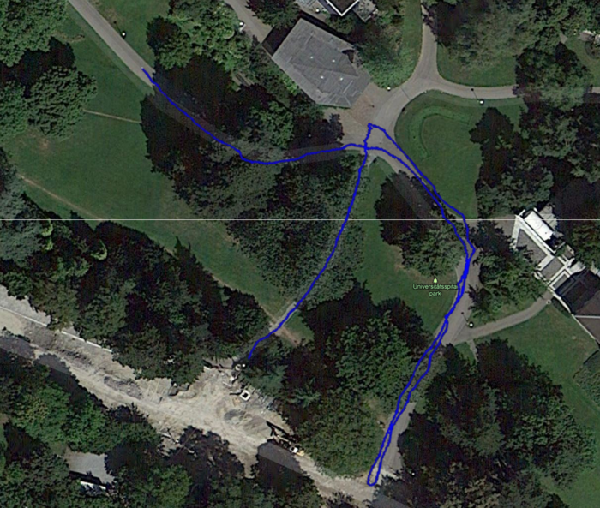
Evaluation [Honegger et al, ICRA 2013]
1.6m altitude, manual flight
Pure integration of position from velocities (no GPS)
Honegger et al, ICRA 2013

Slide 24
Alternative Methods
Stereo camera or depth sensor → next week
Wide-angle camera + IMU (no ultrasound)

Slide 25
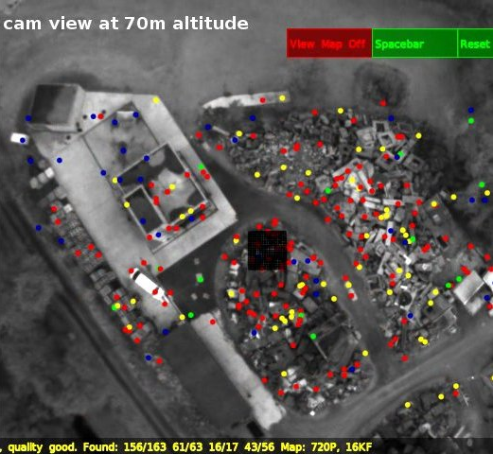
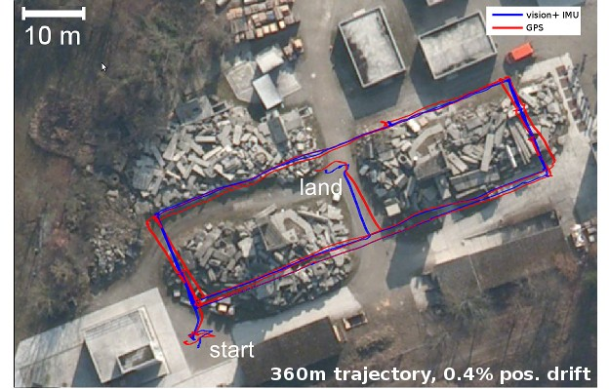
Visual Odometry using PTAM [Weiss et al., ICRA 2012]
Build sparse 3D map from visual features
Based on PTAM library [Klein and Murray, ISMAR 2007]
Drop old keyframes to keep computation time constant
Use IMU to estimate scale
Stephan Weiss, Markus W. Achtelik, Simon Lynen, Margarita Chli and Roland Siegwart. Real-time Onboard Visual-Inertial State Estimation and
Self-Calibration of MAVs in Unknown Environments. In IEEE International Conference on Robotics and Automation (ICRA), 2012.
http://wiki.ros.org/ethzasl_ptam

Slide 26
Visual Odometry using PTAM [Weiss et al., ICRA 2012]
Stephan Weiss, Markus W. Achtelik, Simon Lynen, Margarita Chli and Roland Siegwart. Real-time Onboard Visual-Inertial State Estimation and Self-Calibration of MAVs in Unknown Environments. In IEEE International Conference on Robotics and Automation (ICRA), 2012. https://www.youtube.com/watch?v=wbEzp-L3NDo

Slide 27
Lessons Learned
Visual odometry for UAVs
Typical sensor setup and basic algorithm
Alternative methods
Next week: Cutting-edge research results from our group

