Slide 1
Autonomous Navigation for Flying Robots Lecture 7.1: 2D Motion Estimation in Images
Jürgen Sturm
Technische Universität München

Slide 2
3D to 2D Perspective Projections
Richard Szeliski, Computer Vision: Algorithms and Applications
http://szeliski.org/Book/

Slide 3
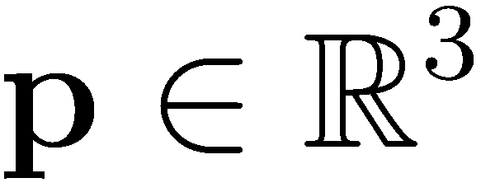
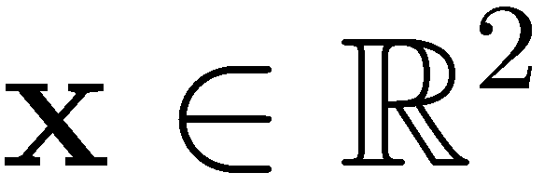
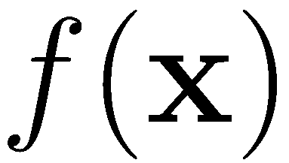
3D to 2D Perspective Projections
Richard Szeliski, Computer Vision: Algorithms and Applications
http://szeliski.org/Book/

Slide 4
Images
We can think of an image as a function
gives the intensity at position
Realistically, the image function is only defined on a rectangle and has finite range

Slide 5
Digital Images
Image function is sampled discrete pixel locations
Image can be represented as a matrix
111 | 115 | 113 | 111 | 112 | 111 | 112 | 111
135 | 138 | 137 | 139 | 145 | 146 | 149 | 147
163 | 168 | 188 | 196 | 206 | 202 | 206 | 207
180 | 184 | 206 | 219 | 202 | 200 | 195 | 193
189 | 193 | 214 | 216 | 104 | 79 | 83 | 77
191 | 201 | 217 | 220 | 103 | 59 | 60 | 68
195 | 205 | 216 | 222 | 113 | 68 | 69 | 83
199 | 203 | 223 | 228 | 108 | 68 | 71 | 77

Slide 6
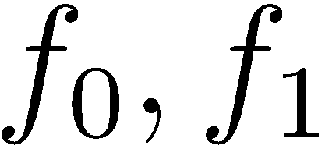
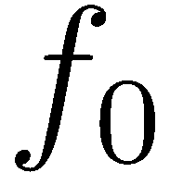
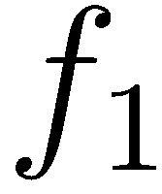
Problem Statement
Given: two camera images
Goal: estimate the camera motion
For the moment, let’s assume that the camera only moves in the xy-plane, i.e.,
Extension to 3D follows

Slide 7
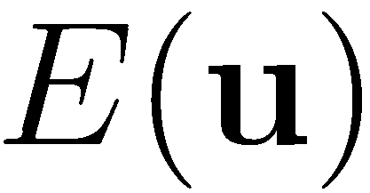
General Idea
Define an error metric that defines how well the two images match given a motion vector
Find the motion vector with the lowest error

Slide 8
Error Metrics for Image Comparison
Sum of Squared Differences (SSD) with displacement and residual errors

Slide 9
Windowed SSD
Images (and image patches) have finite size
Standard SSD has a bias towards smaller overlaps (less error terms)
Solution: divide by the overlap area
Root mean square error

Slide 10
Cross Correlation
Maximize the product (instead of minimizing the differences)
Normalized cross correlation (between -1..1)
Less sensitive to illumination changes

Slide 11
General Idea
Define an error metric that defines how well the two images match given a motion vector
Find the motion vector with the lowest error

Slide 12
Finding the minimum
Full search (e.g., ±16 pixels)
Gradient descent
Hierarchical motion estimation

Slide 13
Motion Estimation
Perform Gauss-Newton minimization on the SSD energy function (Lucas and Kanade, 1981)
Gauss-Newton minimization
Linearize residuals w.r.t. to camera motion
Yields quadratic cost function
Build normal equations and solve linear system

Slide 14
Motion Estimation
Error function
Linearize in u

Slide 15
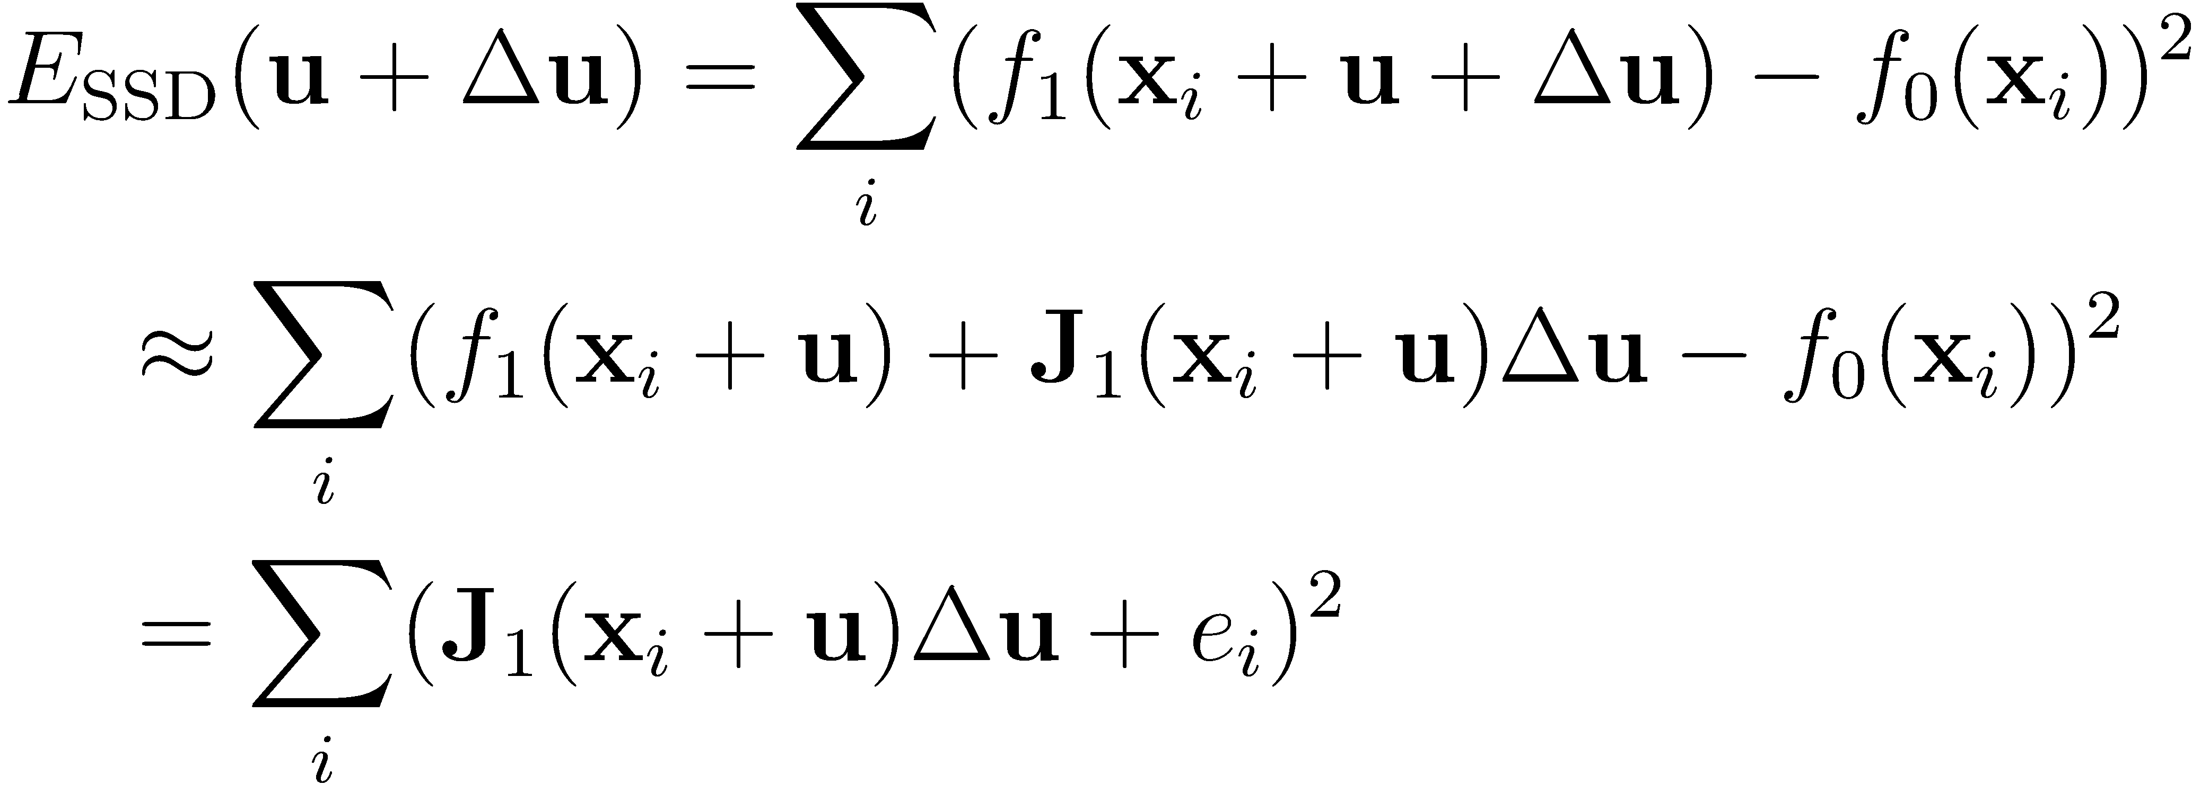
Motion Estimation
Taylor expansion of energy function with

Slide 16
Least Squares Minimization
Goal: Minimize
Solution: Compute derivative and set to zero with and

Slide 17
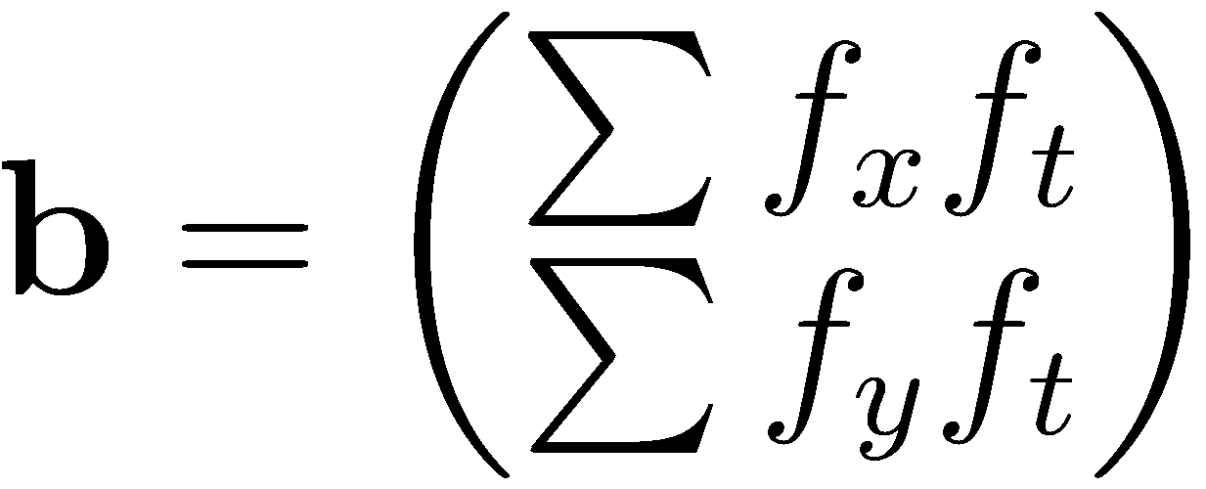
Least Squares Minimization
Step 1: Compute A,b from image gradients using with and

Slide 18
Least Squares Minimization
Step 2: Solve linear system
Note: All of the required computations are super-fast!
In step 1: image gradients + summation to build A,b
In step 2: solve a 2x2 linear equation

Slide 19
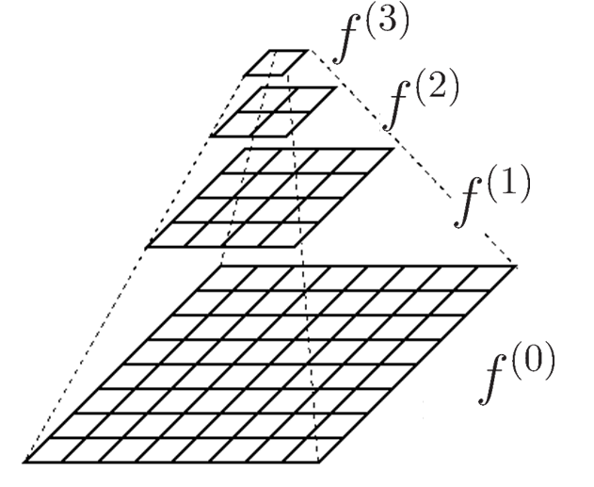
Hierarchical Motion Estimation
Construct image pyramid by downsampling
Estimate motion on coarse level
Use as initialization for next finer level

Slide 20
Covariance of the Estimated Motion
Assuming (small) Gaussian noise in the images with
… results in uncertainty in the motion estimate with covariance (e.g., useful for Kalman filter)

Slide 21
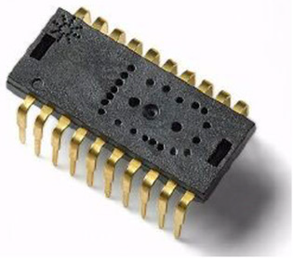
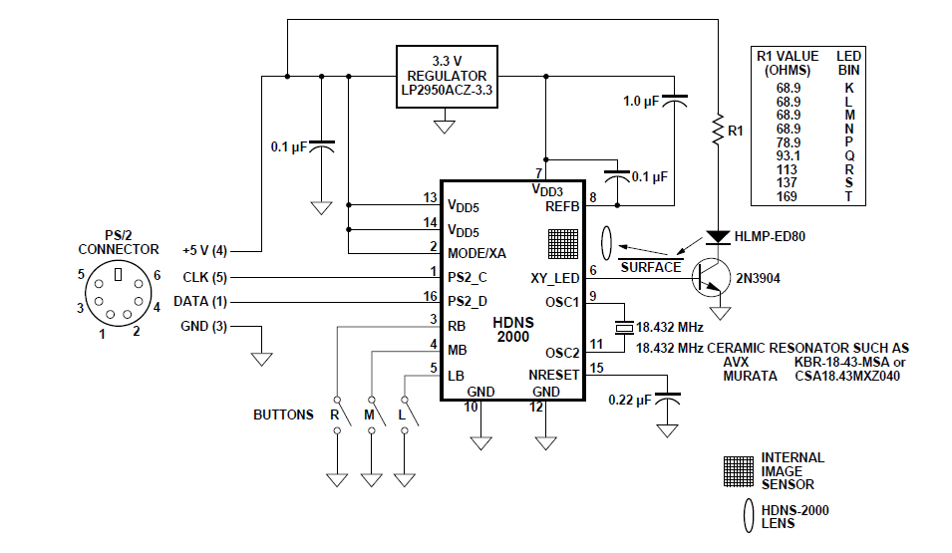
Optical Computer Mouse (since 1999)
E.g., ADNS3080 from Agilent Technologies, 2005
6400 fps
30x30 pixels
4 USD
http://www.alldatasheet.com/datasheet-pdf/pdf/203607/AVAGO/ADNS-3080.html

Slide 22
Image Patches
Sometimes we are interested of the motion of small image patches
Problem: some patches are easier to track than others
Which patches are easy/difficult to track?
How can we recognize “good” patches?

Slide 23
Image Patches
Sometimes we are interested of the motion of a small image patches
Problem: some patches are easier to track than others

Slide 24
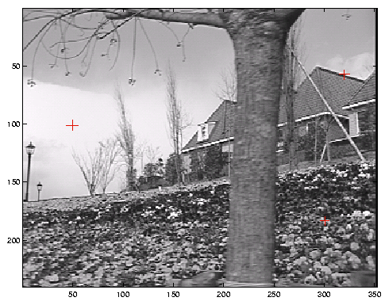
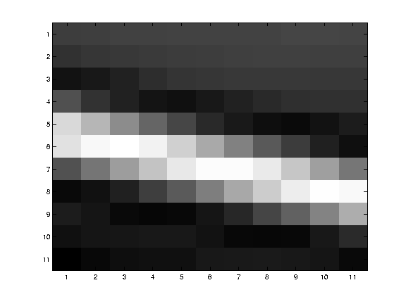
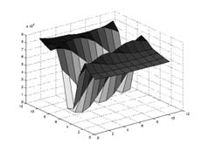
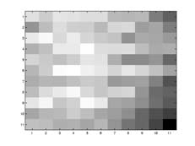
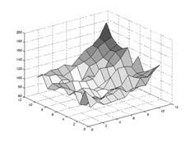
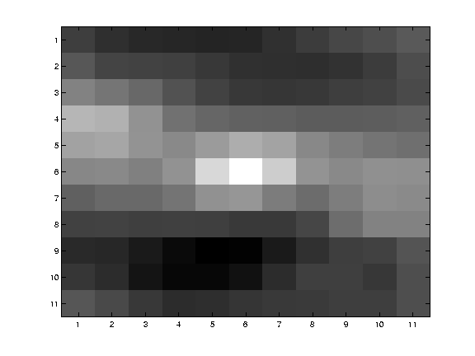
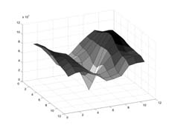
Example
Let’s look at the shape of the energy
Richard Szeliski, Computer Vision: Algorithms and Applications
http://szeliski.org/Book/

Slide 25
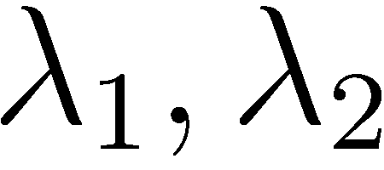
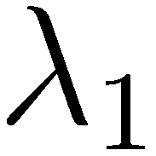
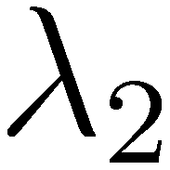
Corner Detection
Idea: Inspect eigenvalues of matrix A (Hessian)
small → no point of interest
large, small → edge
large → corner

Slide 26
Corner Detection
Harris detector (does not need eigenvalues)
Shi-Tomasi (or Kanade-Lucas)

Slide 27
Other Detectors
Förstner detector: localize corner with sub-pixel accuracy
FAST corners: learn decision tree, minimize number of tests → super fast
Difference of Gaussians (DoG): scale-invariant detector used for SIFT
…

Slide 28
Kanade-Lucas-Tomasi (KLT) Tracker
Algorithm
Find (Shi-Tomasi) corners in first frame and initialize tracks
Track from frame to frame
Delete track if error exceeds threshold
Initialize additional tracks when necessary
Repeat step 2-4

Slide 29
KLT Tracker
KLT tracker is highly efficient (real-time on CPU) but provides only sparse motion vectors
Dense optical flow methods require GPU

Slide 30
Demo of a KLT Tracker
Visual Servoing Platform (ViSP), 2010. http://www.irisa.fr/lagadic/visp/visp.html
https://www.youtube.com/watch?v=a0B2nBj4FAM

Slide 31
Lessons Learned
2D motion estimation
Cost functions
Optical computer mouse
Corner detectors
KLT Tracker
Next: Visual odometry

