Slide 1
Autonomous Navigation for Flying Robots Lecture 5.2: Recap on Probability Theory
Jürgen Sturm
Technische Universität München

Slide 2
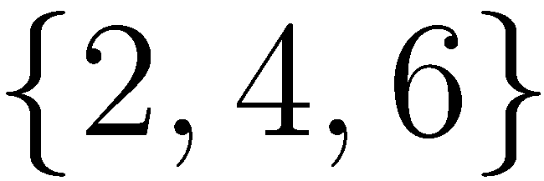
Probability Theory
Random experiment that can produce a number of outcomes, e.g., rolling a dice
Sample space, e.g.,
Event is subset of outcomes, e.g.,
Probability , e.g.,

Slide 3
Axioms of Probability Theory

Slide 4
A Closer Look at Axiom 3

Slide 5
Discrete Random Variables
denotes a random variable
can take on a countable number of values in
is the probability that the random variable takes on value
is called the probability mass function
Example:

Slide 6
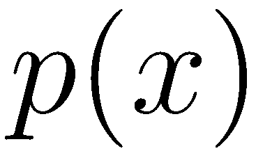
Continuous Random Variables
takes on continuous values
or is called the probability density function (PDF)
Example
Thrun, Burgard, Fox: Probabilistic Robotics. MIT Press, 2005
http://mitpress.mit.edu/books/probabilistic-robotics

Slide 7
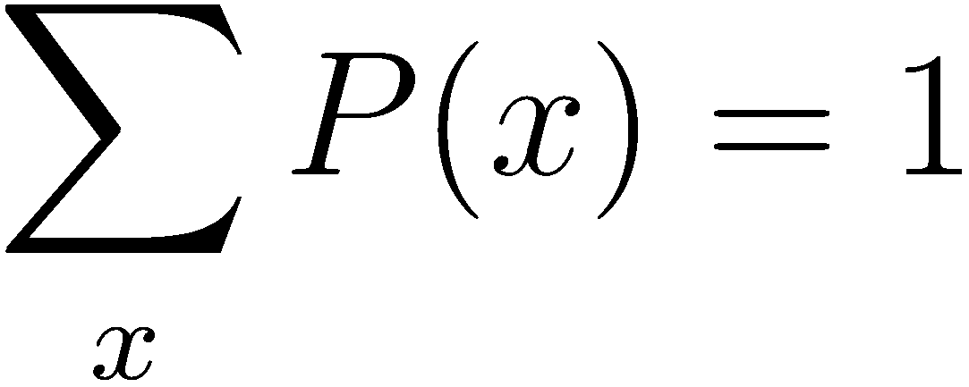
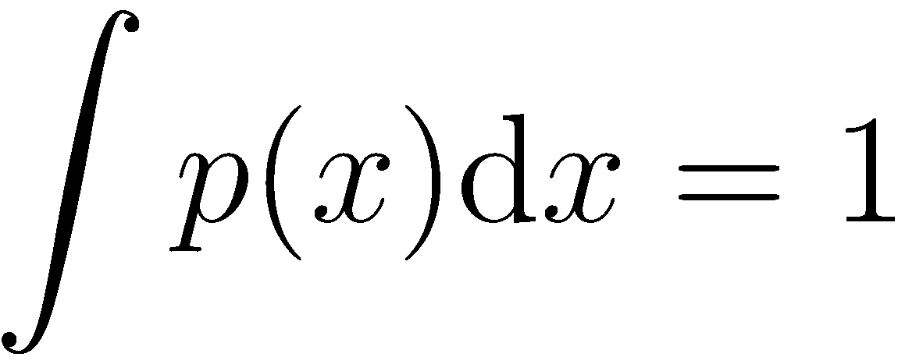
Proper Distributions Sum To One
Discrete case
Continuous case

Slide 8
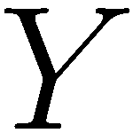
Joint and Conditional Probabilities
If and are independent then
is the probability of x given y
If and are independent then

Slide 9
Conditional Independence
Definition of conditional independence
Equivalent to
Note: this does not necessarily mean that

Slide 10
Marginalization
Discrete case
Continuous case

Slide 11
Example: Marginalization
P(X,Y) | x₁ | x₂ | x₃ | x₄ | P(Y)↓
y₁ | 1/8 | 1/16 | 1/32 | 1/32 | 1/4
y₂ | 1/16 | 1/8 | 1/32 | 1/32 | 1/4
y₃ | 1/16 | 1/16 | 1/16 | 1/16 | 1/4
y₄ | 1/4 | 0 | 0 | 0 | 1/4
P(X)→ | 1/2 | 1/4 | 1/8 | 1/8 | 1

Slide 12
Expected Value of a Random Variable
Discrete case
Continuous case
The expected value is the weighted average of all values a random variable can take on.
Expectation is a linear operator

Slide 13
Covariance of a Random Variable
Measures the squared expected deviation from the mean

Slide 14
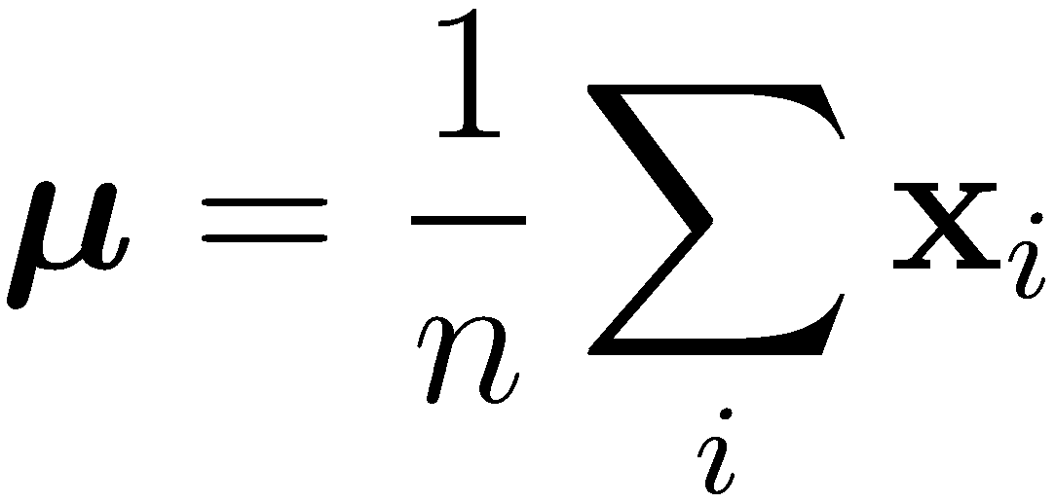
Estimation from Data
Observations
Sample Mean
Sample Covariance

Slide 15
Lessons Learned
Recap on probability theory
Random variables
Joint and conditional probabilities
Marginalization
Mean and covariance
Next: Bayes Law and examples

