Slide 1
Autonomous Navigation for Flying Robots Lecture 2.4: Homework Discussion (of last week)
Jürgen Sturm
Technische Universität München

Slide 2
Course Launch
>15k registrations
>3k completed first week (videos + exercises)

Slide 3
Course Launch
>15k registrations
>3k completed first week (videos + exercises)

Slide 4
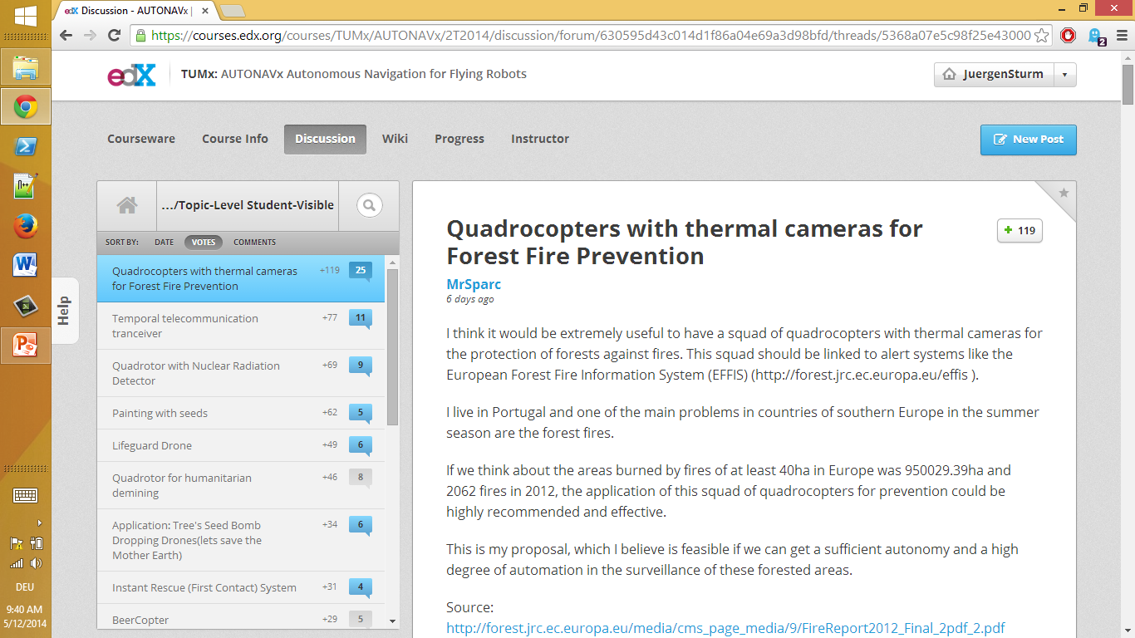

Slide 5
Top Three Applications for Quadrotors
Quadrotors with thermal cameras for forest fire prevention [MrSparc, 119 votes]
Temporal telecommunication tranceiver [npanagia, 77 votes]
Quadrotor with nuclear radiation detector [detik19, 69 votes]

Slide 6
Many Great Ideas
Painting with seeds [MarkTillotson, untimonyred 62+34=96 votes]
Lifeguard drone [chclauson, 49 votes]
Instant rescue / first contact [Barrtos, 31 votes]
BeerCopter [AndreasLohr, 29 votes]
Mosquito Hunter [JasonWang, 27 votes]
Flying umbrella [LudovicGuegan, 11 votes]
…

Slide 7
Potentials and Challenges
Potentials
Completely new applications
Mass market bears an enormeous potential
Challenges
Limited battery life
Limited payload
Safety
Legal regulations

Slide 8
Quadrotor Exercises
Simulator
WebGL
Excellent timings
Race course exercise upcoming in week 8
Parrot Ardrone instructions coming soon
ROS based
Python stub
EdX wiki

