Slide 1
Autonomous Navigation for Flying Robots Lecture 2.2: 2D Geometry
Daniel Cremers
Technische Universität München

Slide 2
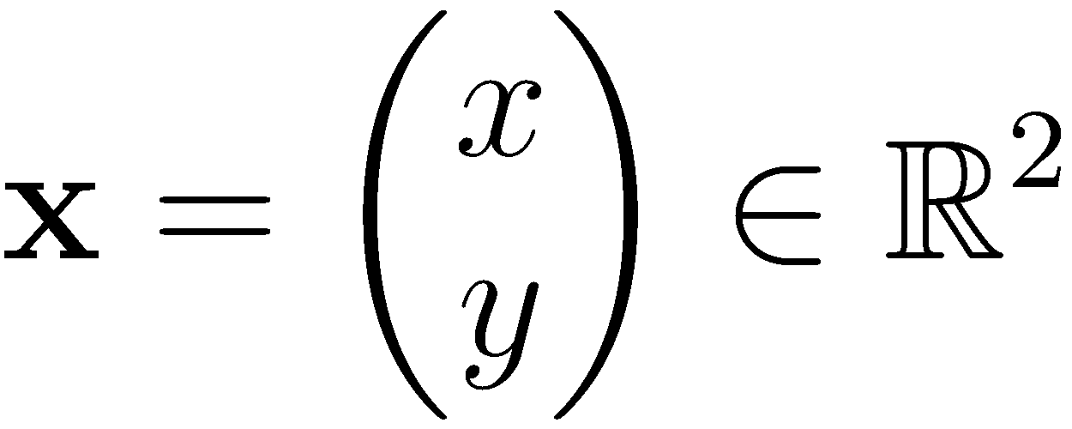
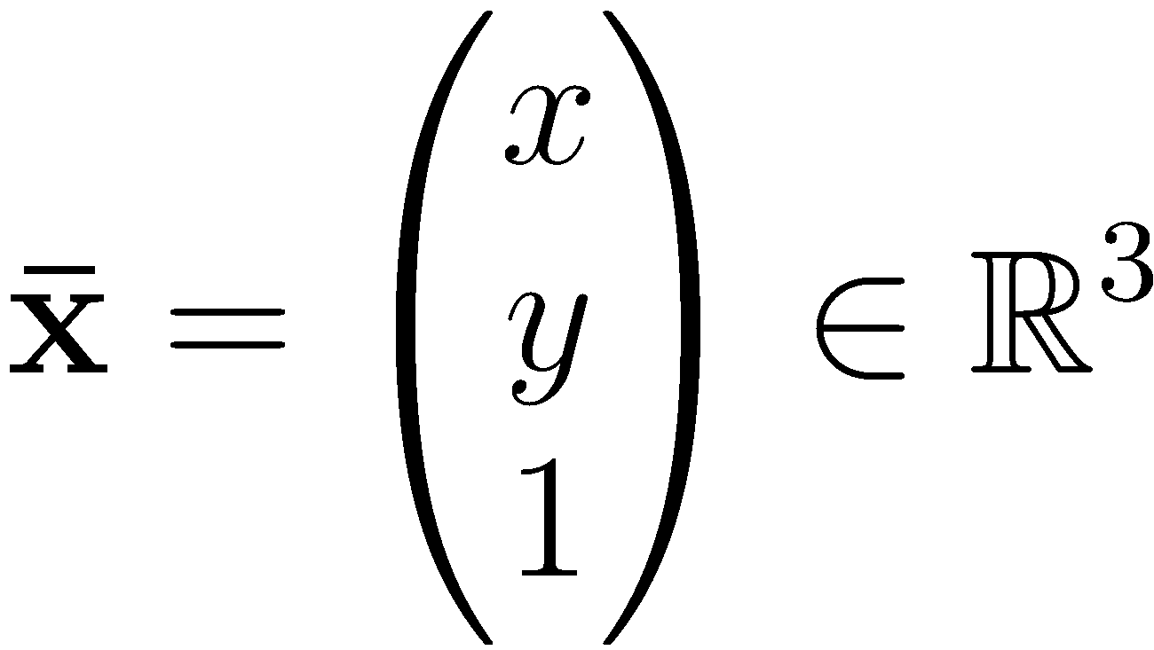
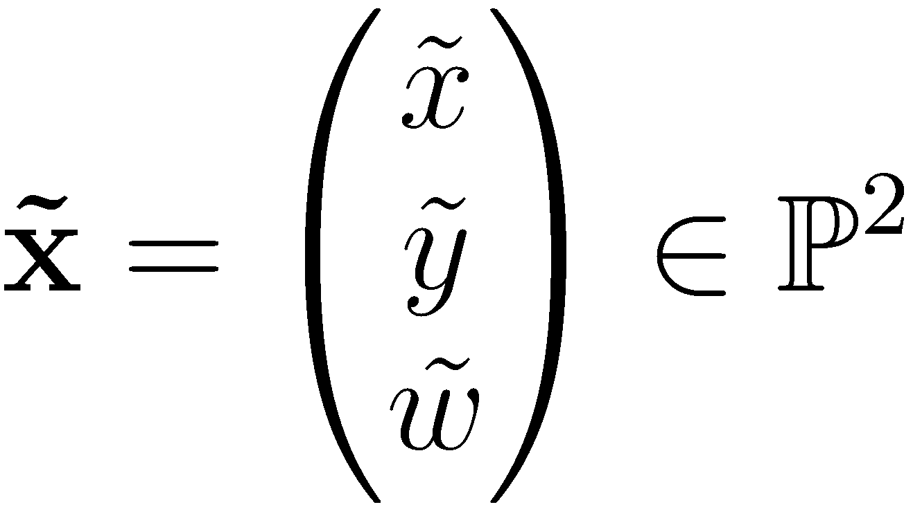
Geometric Primitives in 2D
2D point
Augmented vector
Homogeneous coordinates

Slide 3
Homogeneous Vectors
Homogeneous vectors that differ only by scale represent the same 2D point
Convert back to inhomogeneous coordinates by dividing through last element
Points with are called points at infinity or ideal points

Slide 4
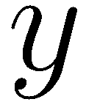
Geometric Primitives in 2D
2D line
2D line equation

Slide 5
Geometric Primitives in 2D
Normalized line equation where and is the distance of the line to the origin

Slide 6
Geometric Primitives in 2D
Line joining two points
Intersection point of two lines

Slide 7
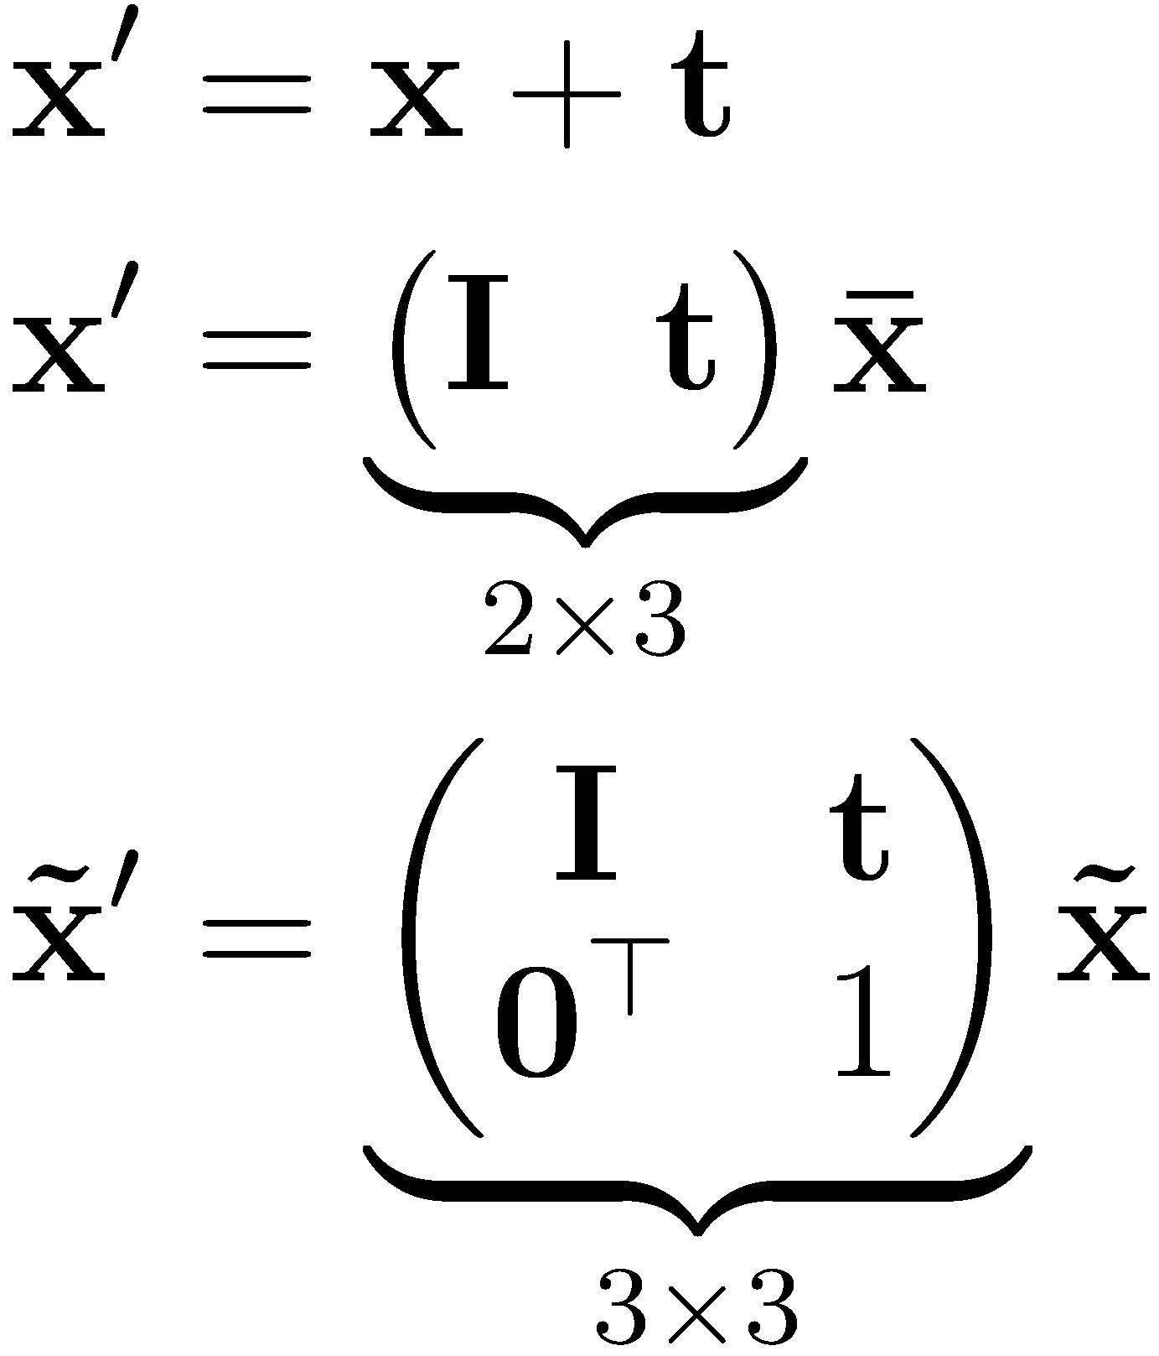
2D Transformations
Translation where is the translation vector, is the identity matrix, and is the zero vector

Slide 8
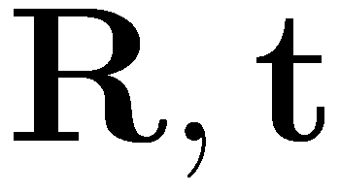
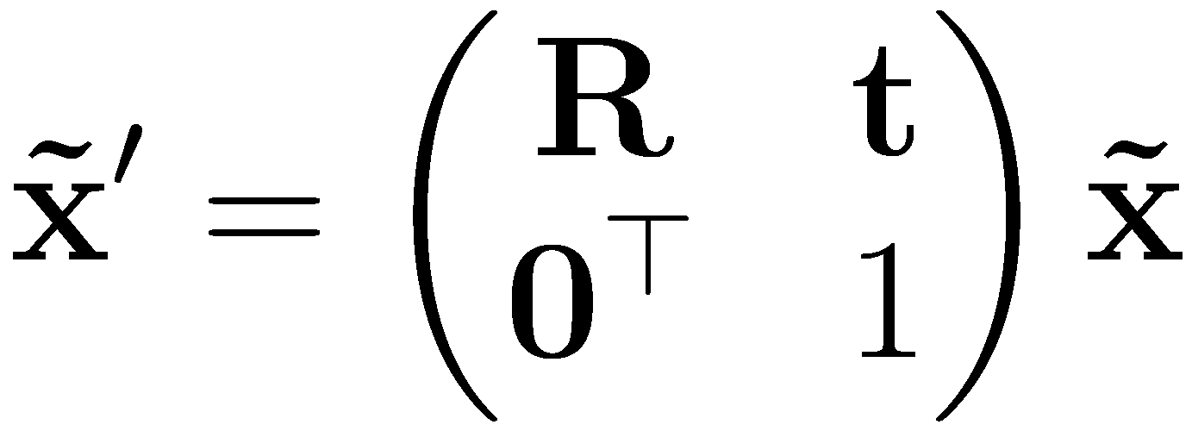
2D Transformations
Rigid body motion or Euclidean transf. (rotation + translation) or where is orthogonal ( ) with
Distances (and angles) are preserved

Slide 9
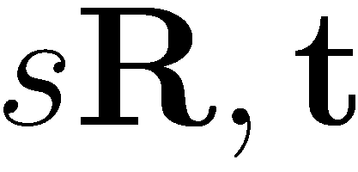
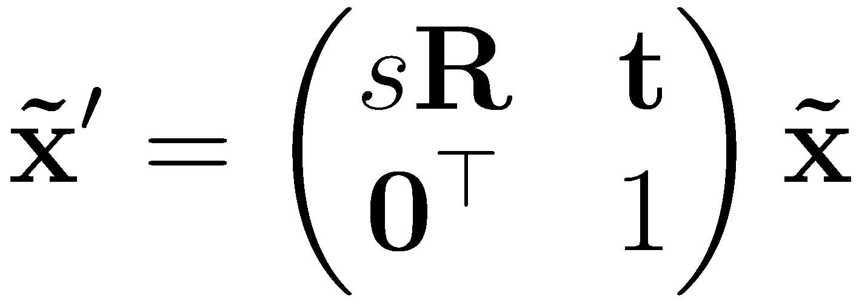
2D Transformations
Scaled rotation/similarity transform or
Preserves angles between lines

Slide 10
2D Transformations
Affine transform
Parallel lines remain parallel

Slide 11
2D Transformations
Homography or projective transf.
Note that is homogeneous (only defined up to scale)
Resulting coordinates are homogeneous
Straight lines remain straight

Slide 12
Lessons Learned
2D points and 2D lines
Homogeneous coordinates
2D transformations
Next: Example

