Slide 1
Autonomous Navigation for Flying Robots Lecture 6.2: Kalman Filter
Jürgen Sturm
Technische Universität München

Slide 2
Motivation
Bayes filter is a useful tool for state estimation
Histogram filter with grid representation is not very efficient
How can we represent the state more efficiently?

Slide 3
Kalman Filter
Bayes filter with continuous states
State represented with a normal distribution
Developed in the late 1950’s
Kalman filter is very efficient (only requires a few matrix operations per time step)
Applications range from economics, weather forecasting, satellite navigation to robotics and many more

Slide 4
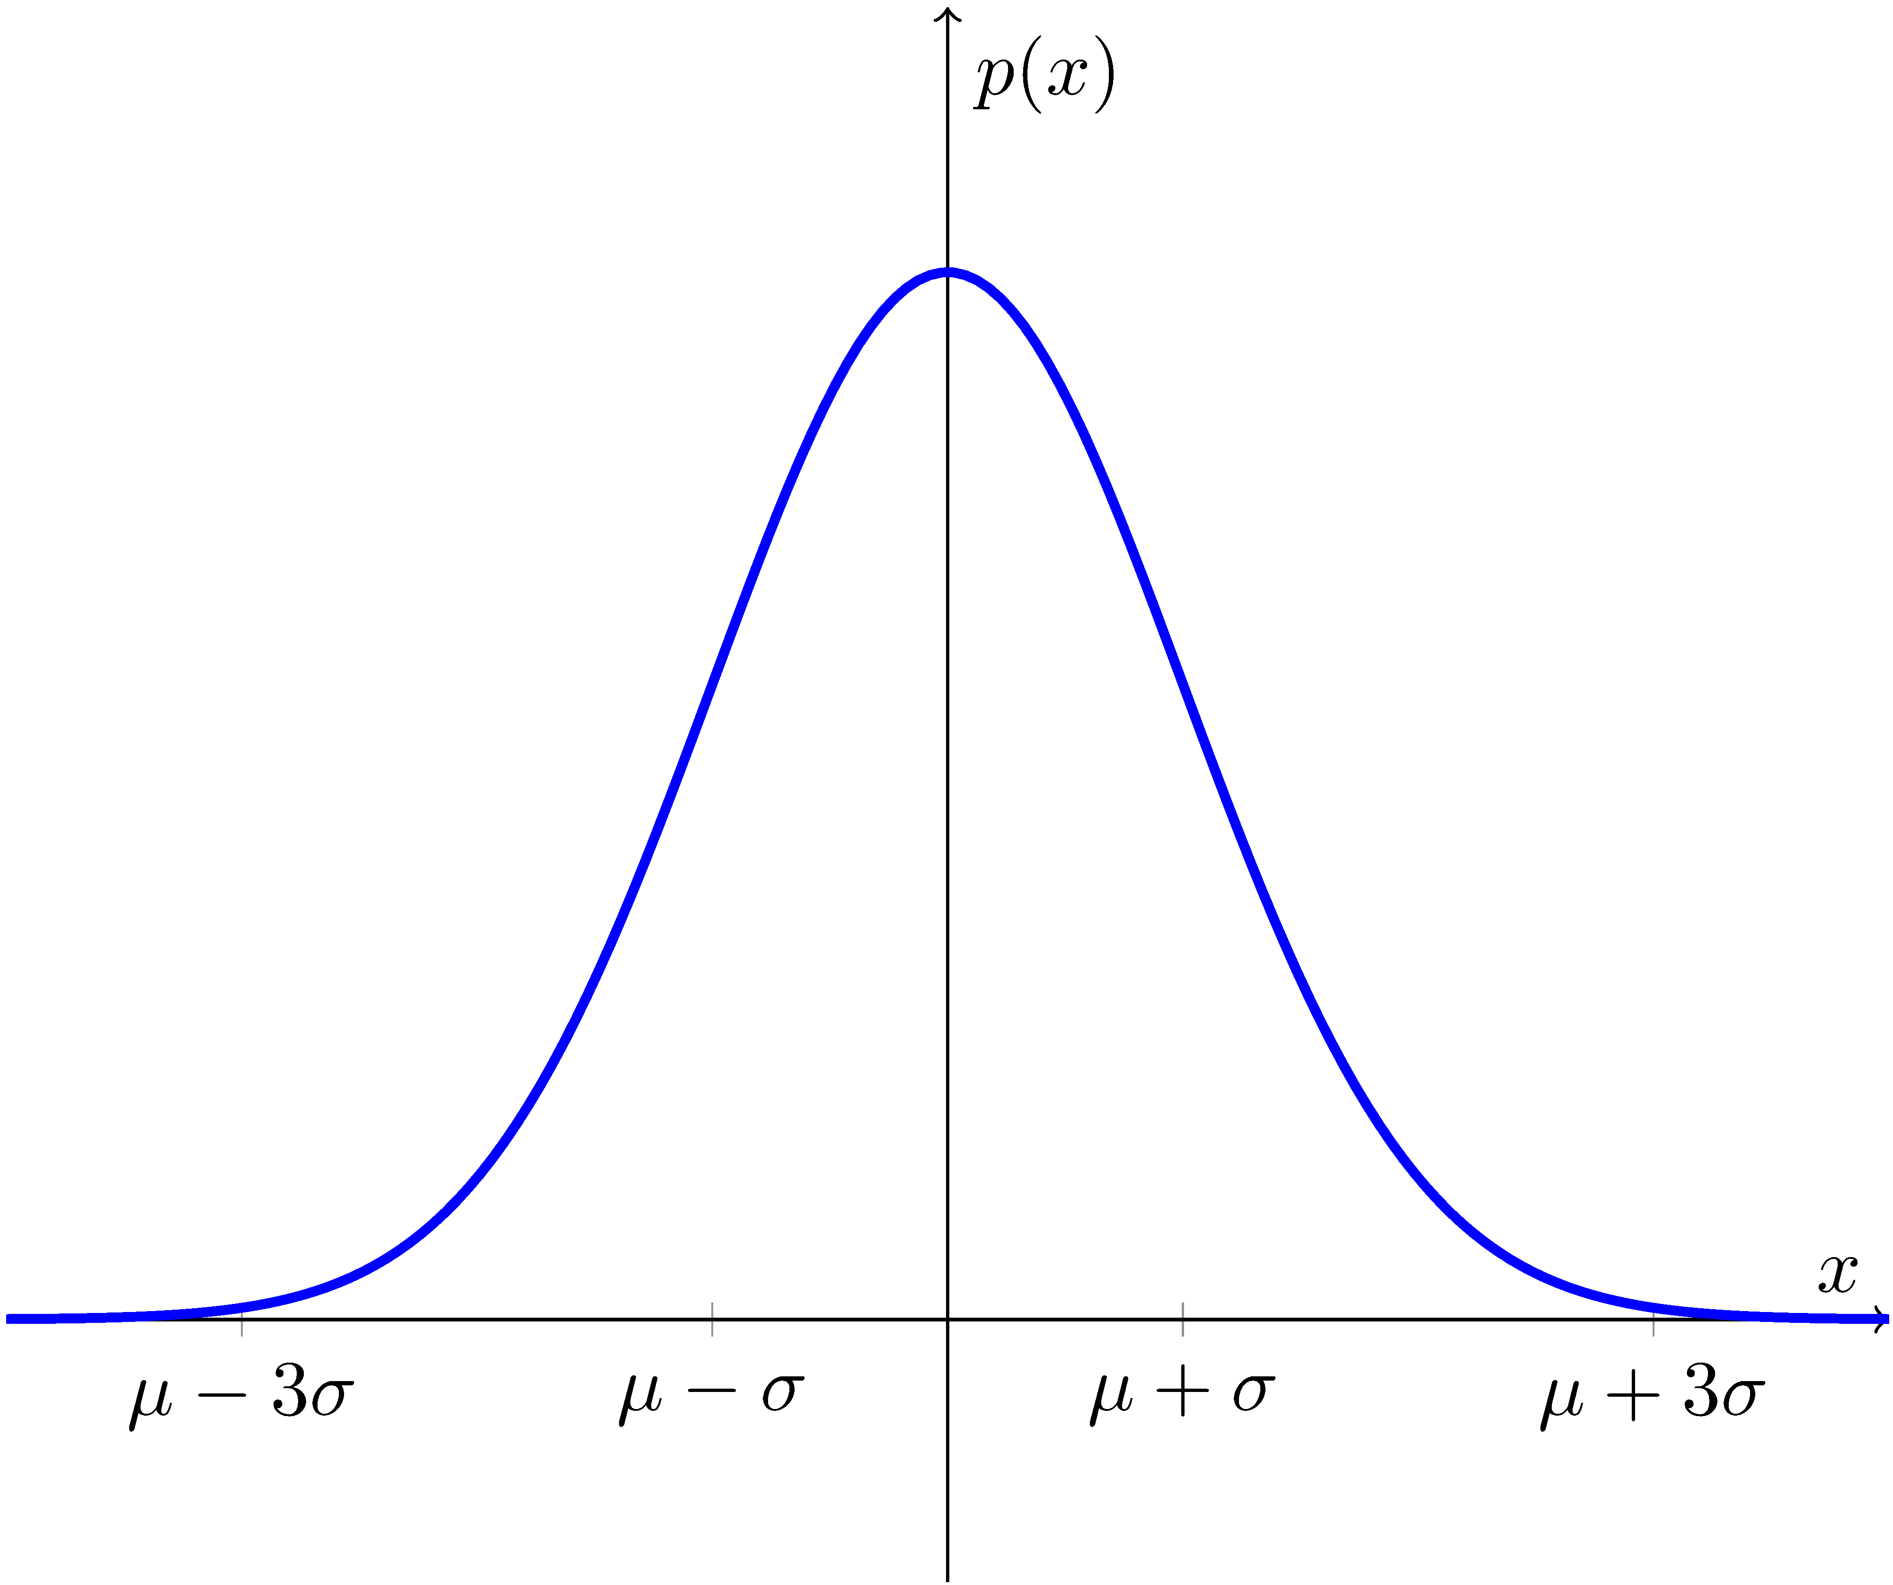
Normal Distribution
Univariate normal distribution
mean
variance (squared std dev)
68% of mass
within 1sd
99% of mass within 3sd

Slide 5
Normal Distribution
Multivariate normal distribution
Mean
Covariance
Probability density function

Slide 6
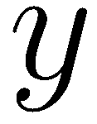
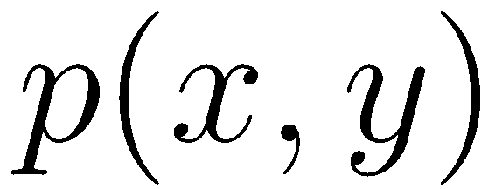
2D Example
Probability density function (pdf)
Isolines (contour plot)
68%
95%

Slide 7
Properties of Normal Distributions
Linear transformation → remains Gaussian
Intersection of two Gaussians → remains Gaussian

Slide 8
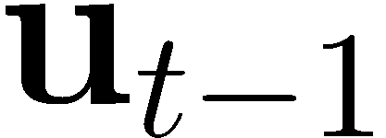
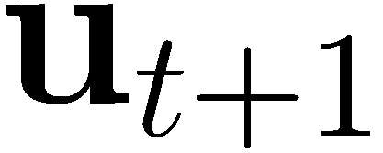
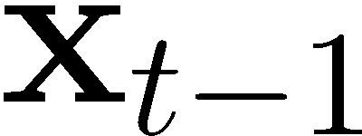
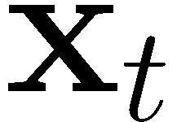
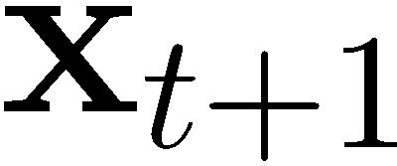
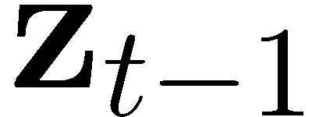
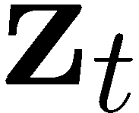
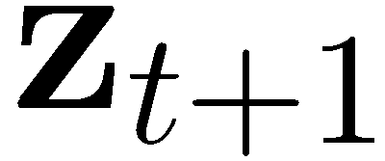
Linear Process Model
Consider a time-discrete stochastic process (Markov chain)

Slide 9
Linear Process Model
Consider a time-discrete stochastic process
Represent the estimated state (belief) by a Gaussian

Slide 10
Linear Process Model
Consider a time-discrete stochastic process
Represent the estimated state (belief) by a Gaussian
Assume that the system evolves linearly over time, then

Slide 11
Linear Process Model
Consider a time-discrete stochastic process
Represent the estimated state (belief) by a Gaussian
Assume that the system evolves linearly over time and depends linearly on the controls

Slide 12
Linear Process Model
Consider a time-discrete stochastic process
Represent the estimated state (belief) by a Gaussian
Assume that the system evolves linearly over time, depends linearly on the controls, and has zero-mean, normally distributed process noise with

Slide 13
Linear Observations
Further, assume we make observations that depend linearly on the state

Slide 14
Linear Observations
Further, assume we make observations that depend linearly on the state and that are perturbed by zero-mean, normally distributed observation noise with

Slide 15
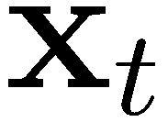
Kalman Filter
Estimates the state of a discrete-time controlled process that is governed by the linear stochastic difference equation
and (linear) measurements of the state with and

Slide 16
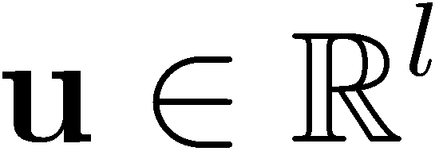
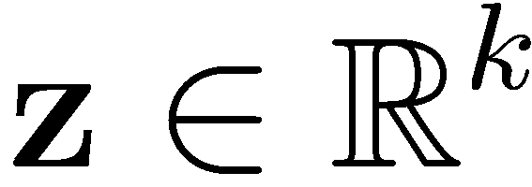
Variables and Dimensions
State
Controls
Observations
Process equation
Measurement equation

Slide 17
Kalman Filter
Initial belief is Gaussian
Next state is also Gaussian (linear transformation)
Observations are also Gaussian

Slide 18
Remember: Bayes Filter Algorithm
For each time step, do
Apply motion model
Apply sensor model

Slide 19
From Bayes Filter to Kalman Filter
For each time step, do
Apply motion model

Slide 20
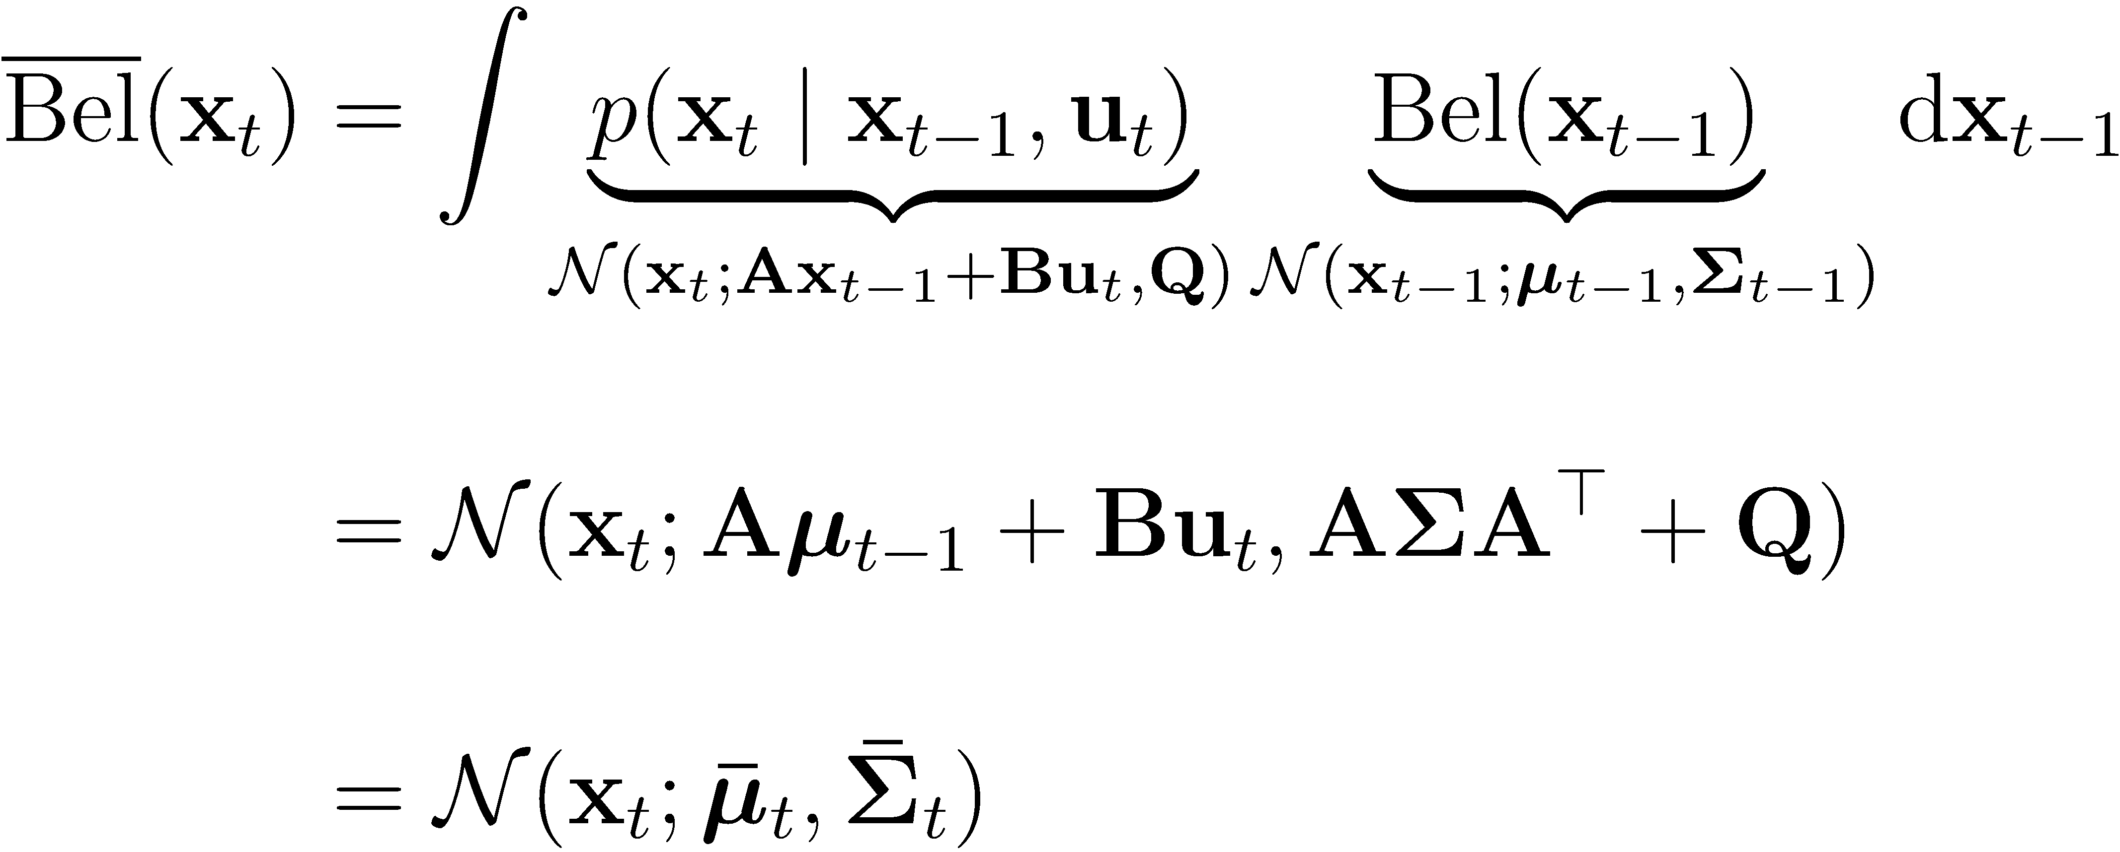
From Bayes Filter to Kalman Filter
For each time step, do
Apply motion model

Slide 21
From Bayes Filter to Kalman Filter
For each time step, do
Apply sensor model with (Kalman gain)

Slide 22
Kalman Filter Algorithm
For each time step, do
Apply motion model (prediction step)
Apply sensor model (correction step) with
See Probabilistic Robotics for full derivation (Chapter 3)

Slide 23
Complexity
Highly efficient: Polynomial in the measurement dimensionality k and state dimensionality n:
Optimal for linear Gaussian systems!
Most robotics systems are nonlinear!

Slide 24
Nonlinear Dynamical Systems
Most realistic robotic problems involve nonlinear functions
Motion function
Observation function
Can we linearize these functions?

Slide 25
Taylor Expansion
Idea: Linearize both functions
Motion function
Observation function

Slide 26
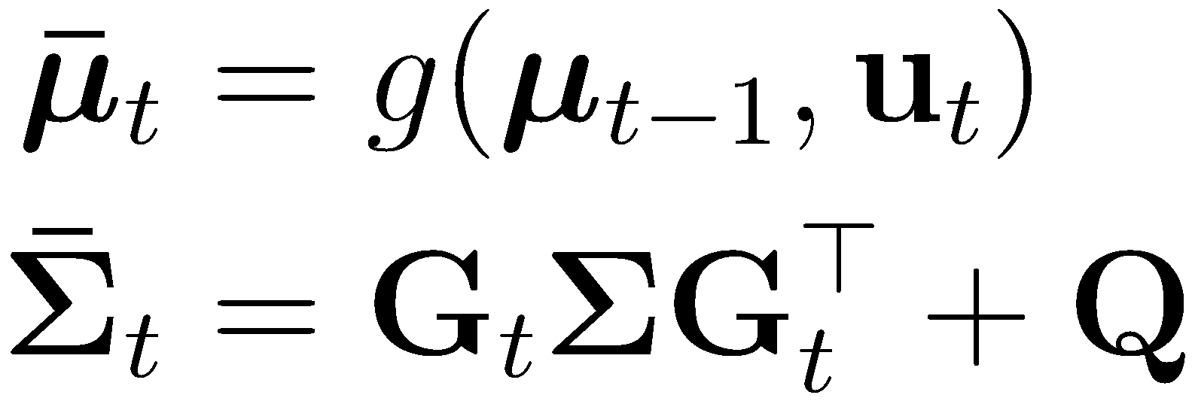
Extended Kalman Filter (EKF)
For each time step, do
Apply motion model (prediction step) with
Apply sensor model (correction step)
with and

Slide 27
Lessons Learned
Kalman filter
Linearization of sensor and motion model
Extended Kalman filter
Next: Example in 2D

