Slide 1
Autonomous Navigation for Flying Robots Lecture 4.4 : PID Control
Jürgen Sturm
Technische Universität München

Slide 2
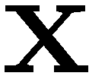
Rigid Body Kinematics
Consider a rigid body
Free floating in 1D space, no gravity

Slide 3
Rigid Body Kinematics
System model
Initial state

Slide 4
Rigid Body Kinematics
In each time instant, we can apply a force
Results in acceleration
Desired position
What will happen if we apply P-control?

Slide 5
P Control
Control law

Slide 6
PD Control
Proportional-derivative control

Slide 7
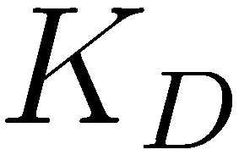
PD Control
Proportional-derivative control
What if we set lower gains for ?

Slide 8
PD Control
Proportional-derivative control
What if we set higher gains for ?

Slide 9
PD Control
What happens when we add gravity?

Slide 10
Gravity compensation
Add as an additional term in the control law
Any known (inverse) dynamics can be included

Slide 11
PD Control
What happens when we have systematic errors? (control/sensor noise with non-zero mean)
Example: unbalanced quadrotor, wind, …

Slide 12
PID Control
Idea: Estimate the system error (bias) by integrating error

Slide 13
PID Control
Idea: Estimate the system error (bias) by integrating error
For steady state systems, this can be reasonable
Otherwise, it may create havoc or even disaster (wind-up effect)

Slide 14
Example: Wind-up effect
Quadrotor gets stuck in a tree → does not reach steady state
What is the effect on the I-term?

Slide 15
De-coupled Control
So far, we considered only single-input, single-output systems (SISO)
Real systems have multiple inputs + outputs
MIMO (multiple-input, multiple-output)
In practice, control is often de-coupled
Controller 1
System
Controller 2

Slide 16
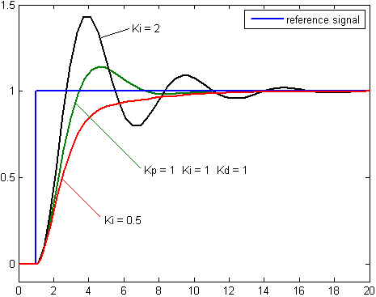
How to Choose the Coefficients?
Gains too large: overshooting, oscillations
Gains too small: long time to converge
Heuristic methods exist
In practice, often tuned manually

Slide 17
Cascaded Control
Robot
Trajectory
0.1 Hz
Localization
Position Control
10 Hz
Attitude Estimation
Attitude Control
1 KHz
RPM Estimation
Motor Speed Control
10 .000 RPM
Sensors
Actuators
Quadrotor Physical World
Kinematics
Dynamics

Slide 18
Assumptions of Cascaded Control
Dynamics of inner loops is so fast that it is not visible from outer loops
Dynamics of outer loops is so slow that it appears as static to the inner loops

Slide 19
Example: Ardrone
Cascaded control
Inner loop runs on embedded PC and controls attitude
Outer loop runs externally and implements position control
Laptop
Ardrone (=seen as the system by the outer loop)
Outer loop
Inner loop
Motors
onboard, 1000Hz
wireless, approx. 15Hz

Slide 20
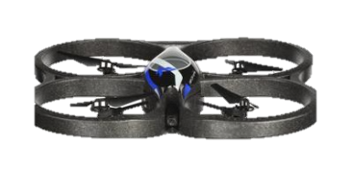
Mechanical Equivalent
PD Control is equivalent to adding spring-dampers between the desired values and the current position
Run the demo from http://wiki.ros.org/tum_ardrone

Slide 21
Lessons Learned
P – proportional term
I – integral term
D – derivative term
De-coupled control
Cascaded control

