Slide 1
Autonomous Navigation for Flying Robots Lecture 3.1: 3D Geometry
Jürgen Sturm
Technische Universität München

Slide 2
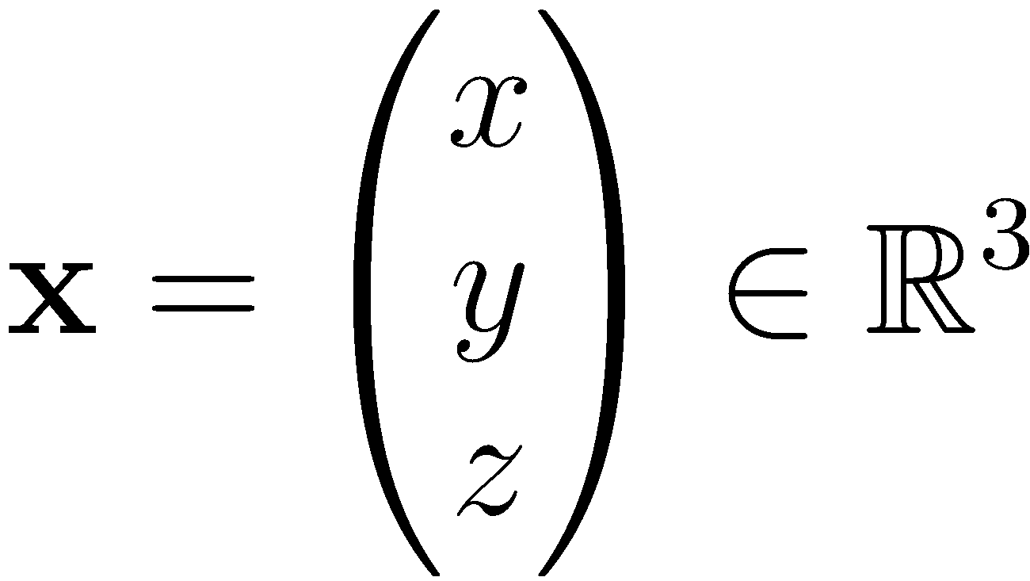
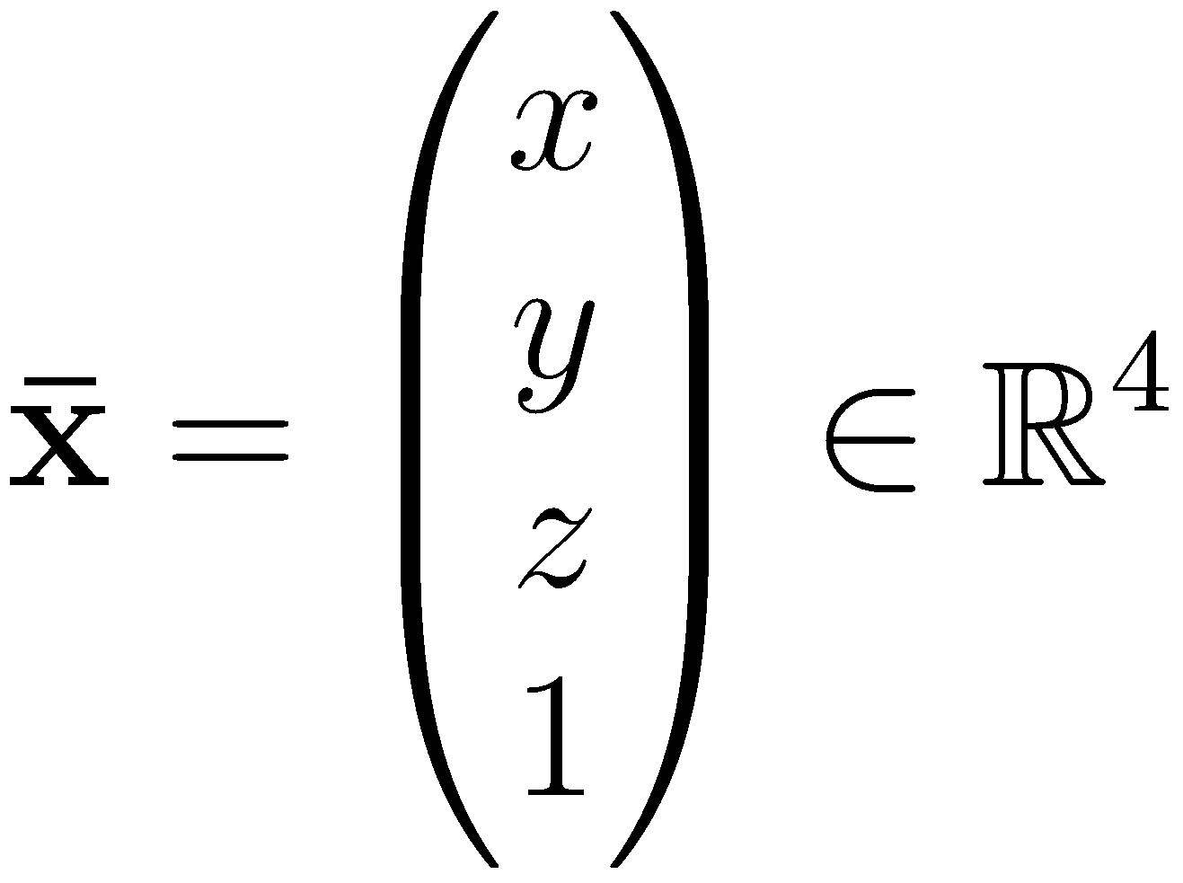
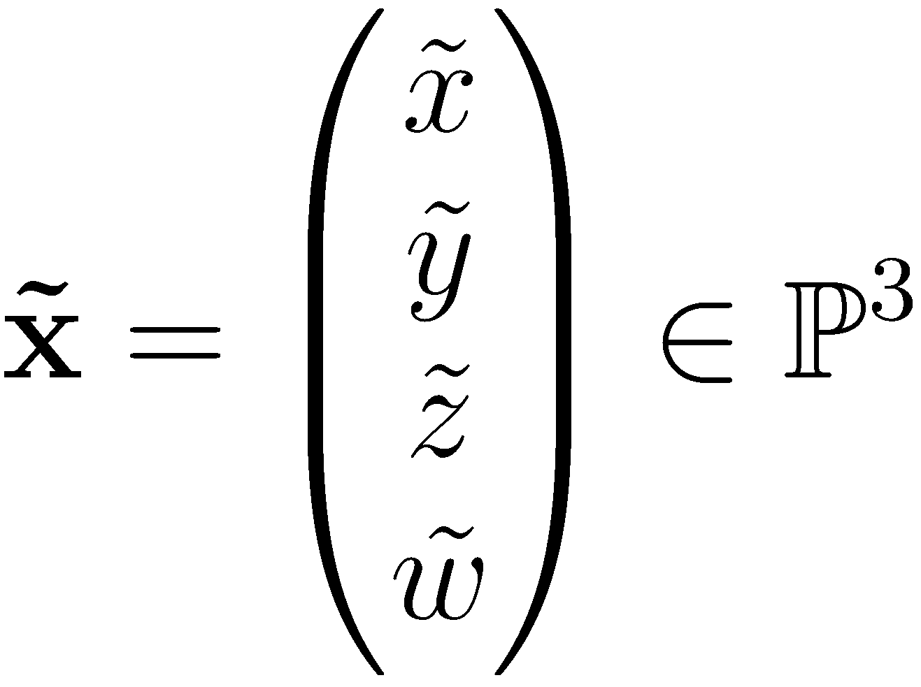
Points in 3D
3D point
Augmented vector
Homogeneous coordinates

Slide 3
Geometric Primitives in 3D
3D line through points
Infinite line:
Line segment joining :

Slide 4
Geometric Primitives in 3D
3D plane
3D plane equation
Normalized plane with unit normal vector and distance

Slide 5
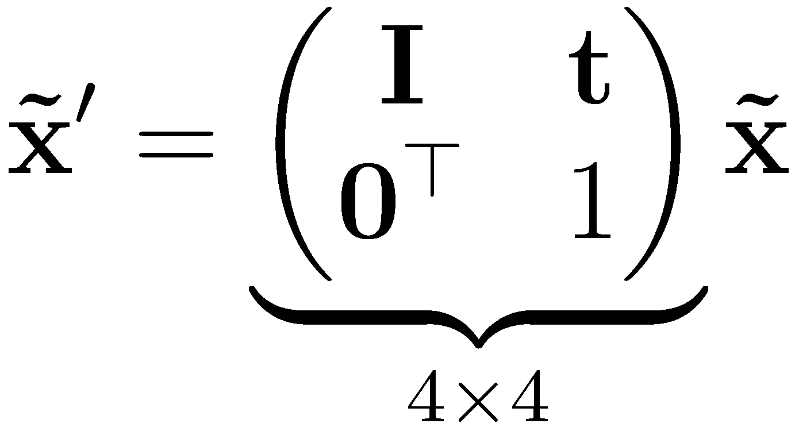
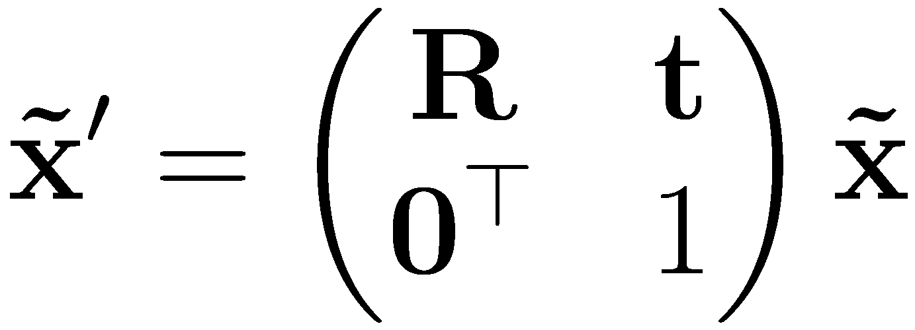
3D Transformations
Translation
Euclidean transform (translation + rotation), (also called the Special Euclidean group SE(3))
Scaled rotation, affine transform, projective transform…

Slide 6
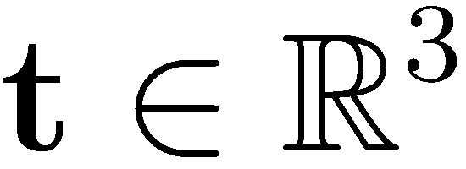
3D Euclidean Transformations
Translation has 3 degrees of freedom
Rotation has 3 degrees of freedom

Slide 7
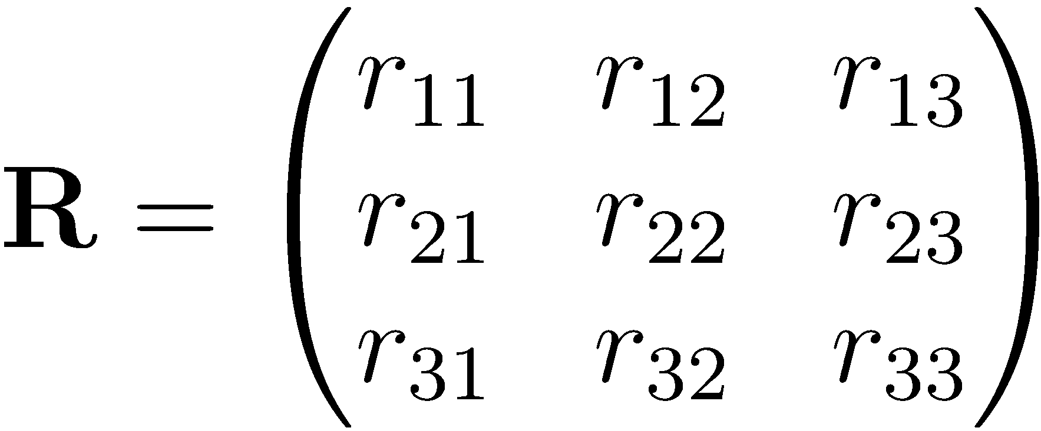
3D Rotations
A rotation matrix is a 3x3 orthogonal matrix
Also called the special orientation group SO(3)
Column vectors correspond to coordinate axes

Slide 8
3D Rotations
What operations do we typically do with rotation matrices?
Invert, concatenate
Estimate/optimize
How easy are these operations on matrices?

Slide 9
3D Rotations
Advantage: Can be easily concatenated and inverted (how?)
Disadvantage: Over-parameterized (9 parameters instead of 3)

Slide 10
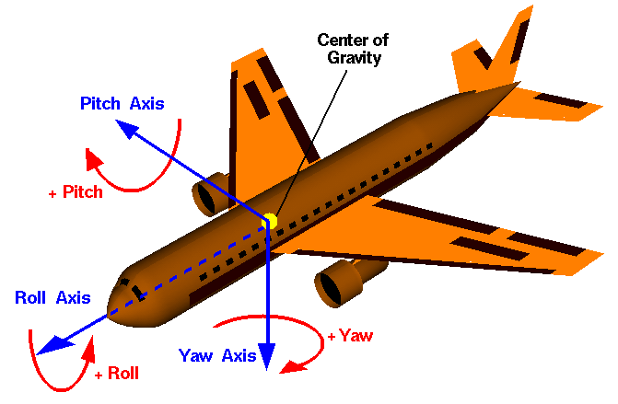
Euler Angles
Product of 3 consecutive rotations (e.g., around X-Y-Z axes)
Roll-pitch-yaw convention is very common in aerial navigation (DIN 9300)
http://en.wikipedia.org/wiki/File:Rollpitchyawplain.png

Slide 11
Roll-Pitch-Yaw Convention
Roll , Pitch , Yaw
Conversion to 3x3 rotation matrix:

Slide 12
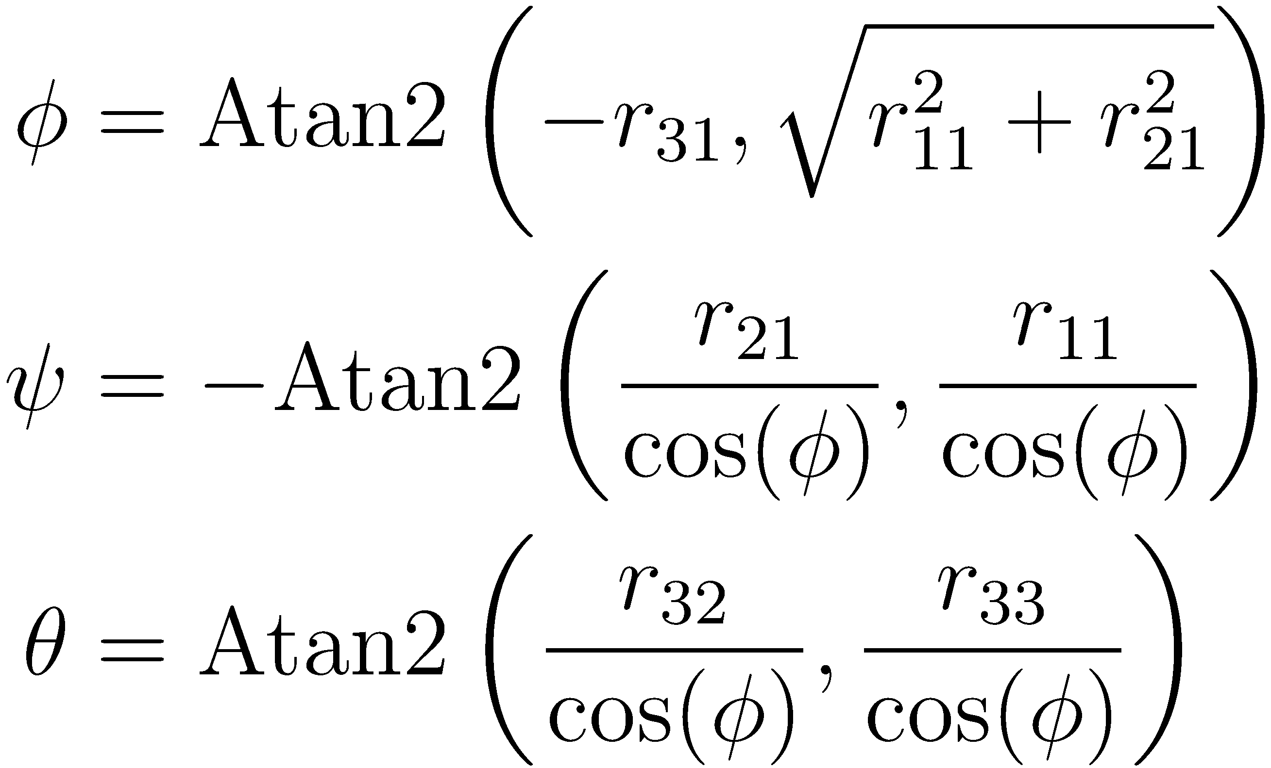
Roll-Pitch-Yaw Convention
Roll , Pitch , Yaw
Conversion from 3x3 rotation matrix:

Slide 13
Euler Angles
Advantage:
Minimal representation (3 parameters)
Easy interpretation
Disadvantages:
Many “alternative” Euler representations exist (XYZ, ZXZ, ZYX, …)
Difficult to concatenate
Singularities (gimbal lock)

Slide 14
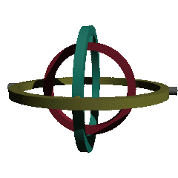
Gimbal Lock
When the axes align, one degree-of-freedom (DOF) is lost:
http://commons.wikimedia.org/wiki/File:Rotating_gimbal-xyz.gif

Slide 15
Axis/Angle
Represent rotation by
rotation axis and
rotation angle
4 parameters
3 parameters
length is rotation angle
also called the angular velocity
minimal but not unique (why?)

Slide 16
Conversion
Rodriguez’ formula
Inverse
see: An Invitation to 3D Vision (Ma, Soatto, Kosecka, Sastry), Chapter 2

Slide 17
Axis/Angle
Also called twist coordinates
Advantages:
Minimal representation
Simple derivations
Disadvantage:
Difficult to concatenate
Slow conversion

Slide 18
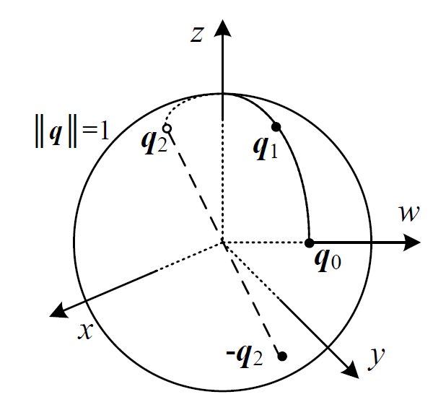
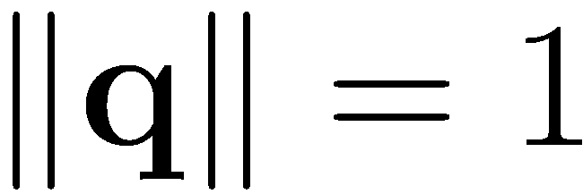
Quaternions
Quaternion
Real and vector part
Unit quaternions have
Opposite sign quaternions represent the same rotation
Otherwise unique
Richard Szeliski, Computer Vision: Algorithms and Applications
http://szeliski.org/Book/

Slide 19
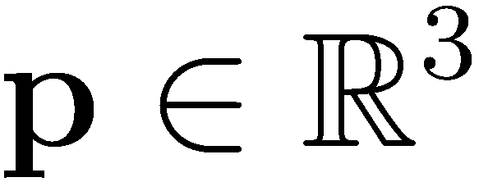
Quaternions
Advantage: multiplication, inversion and rotations are very efficient
Concatenation
Inverse (=flip signs of real or imaginary part)
Rotate 3D vector using a quaternion:

Slide 20
Quaternions
Rotate 3D vector using a quaternion:
Relation to axis/angle representation

Slide 21
3D Orientations
Note: In general, it is very hard to “read” 3D orientations/rotations, no matter in what representation
Observation: They are usually easy to visualize and can then be intuitively interpreted
Advice: Use 3D visualization tools for debugging (RVIZ, libqglviewer, …)

Slide 22
3D to 2D Perspective Projections
Richard Szeliski, Computer Vision: Algorithms and Applications
http://szeliski.org/Book/

Slide 23
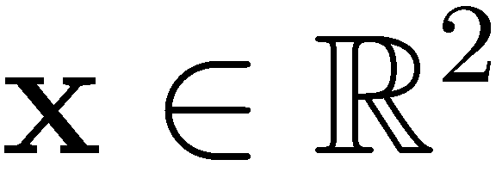
3D to 2D Perspective Projections
Richard Szeliski, Computer Vision: Algorithms and Applications
http://szeliski.org/Book/

Slide 24
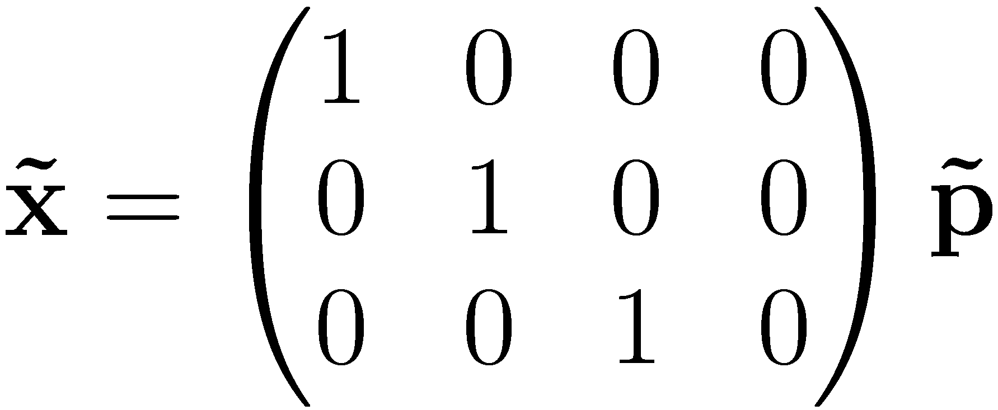
3D to 2D Perspective Projections
Pin-hole camera model
Note: is homogeneous, needs to be normalized

Slide 25
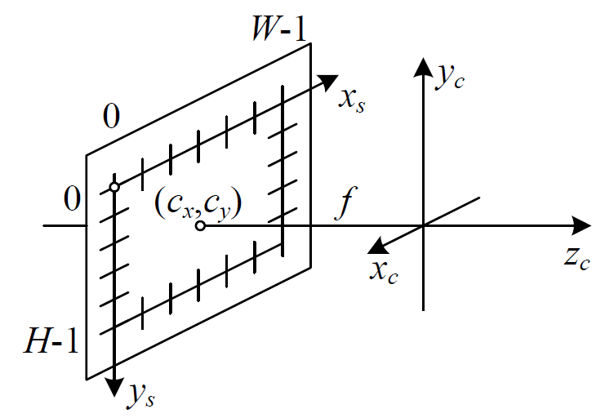
Camera Intrinsics
So far, 2D point is given in meters on image plane
But: we want 2D point be measured in pixels (as the sensor does)
Richard Szeliski, Computer Vision: Algorithms and Applications
http://szeliski.org/Book/

Slide 26
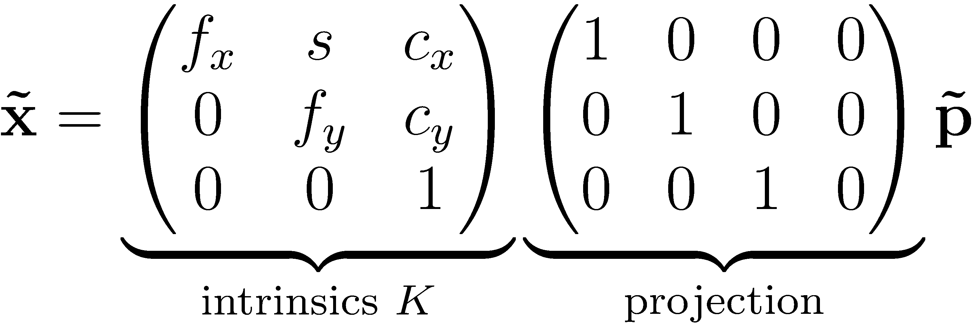
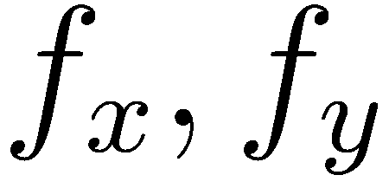
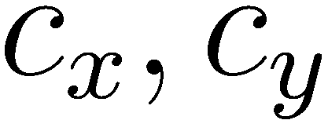
Camera Intrinsics
Need to apply some scaling/offset
Focal length
Camera center
Skew

Slide 27
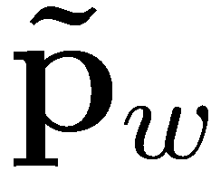
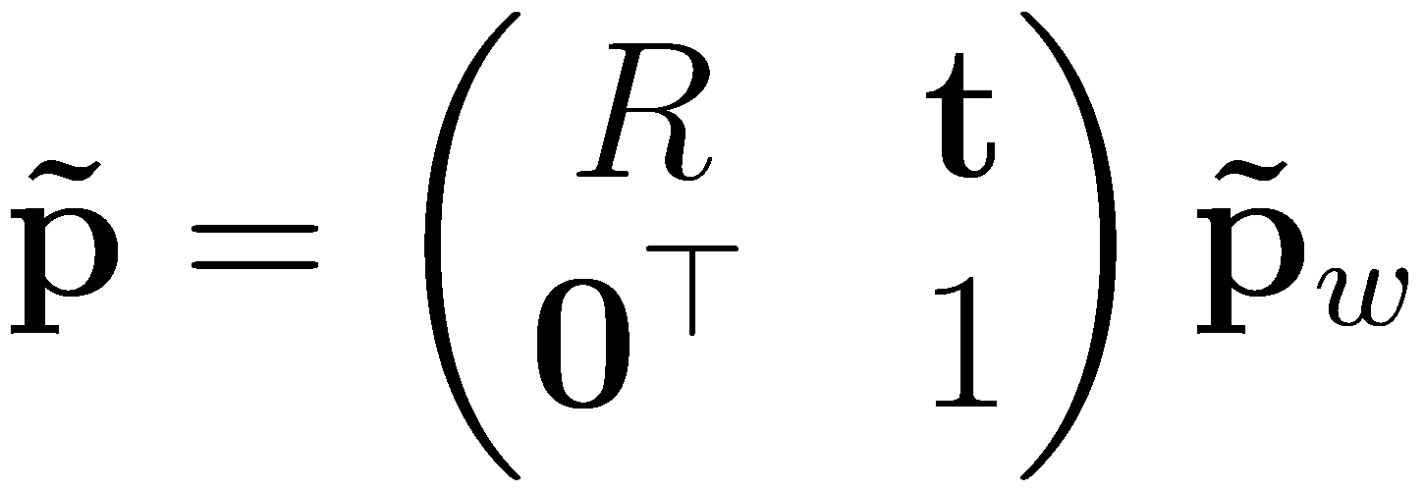
Camera Extrinsics
Assume is given in world coordinates
Transform from world to camera (also called the camera extrinsics)
Projection of 3D world points to 2D pixel coordinates:

Slide 28
Lessons Learned
3D points, lines, planes
3D transformations
Different representations for 3D orientations
Choice depends on application
Which representations do you remember?
3D to 2D perspective projections
You really have to know 2D/3D transformations by heart (for more info, read Szeliski, Chapter 2, available online)

