Slide 1
Autonomous Navigation for Flying Robots Lecture 2.1: Recap on Linear Algebra
Daniel Cremers
Technische Universität München

Slide 2
Notation
Scalar
Vector
Matrix

Slide 3
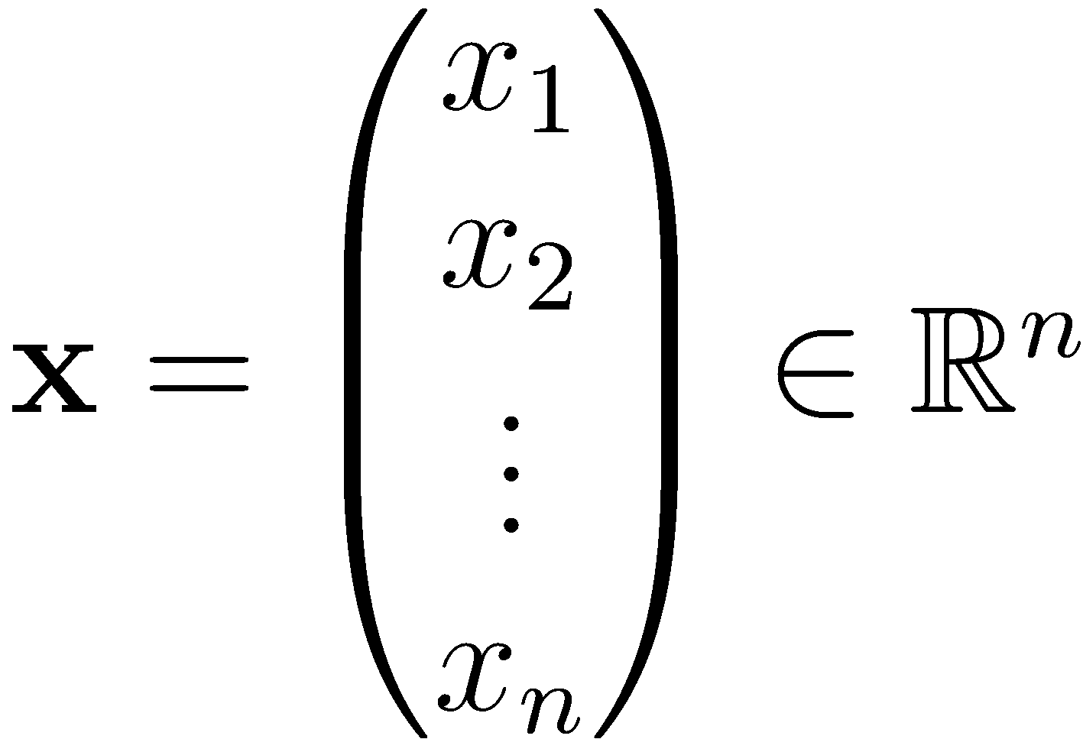
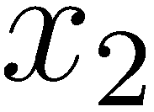
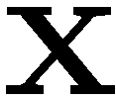
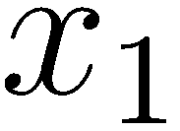
Vectors
Vector and its coordinates
A vector represents a point in n-dimensional space

Slide 4
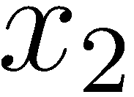
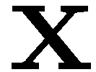
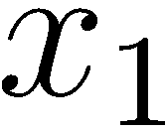
Operations on Vectors
Scalar multiplication
Addition/subtraction
Length
Normalized vector
Dot product
Cross product

Slide 5
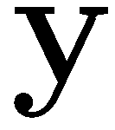
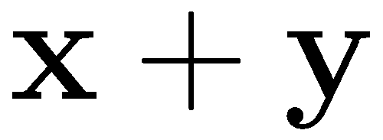
Operations on Vectors
Scalar multiplication
Addition/subtraction
Length
Normalized vector
Dot product
Cross product

Slide 6
Operations on Vectors
Scalar multiplication
Addition/subtraction
Length
Normalized vector
Dot product
Cross product

Slide 7
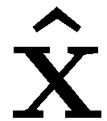
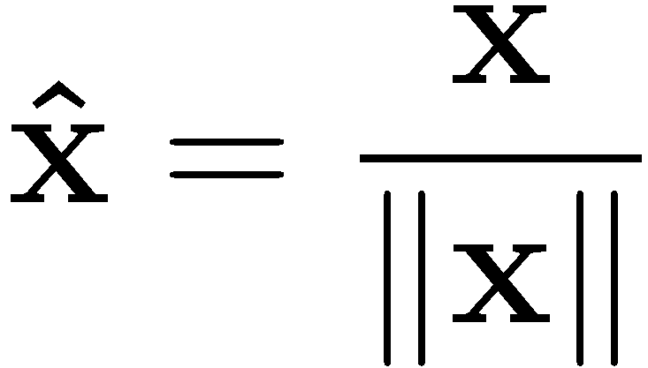
Operations on Vectors
Scalar multiplication
Addition/subtraction
Length
Normalized vector
Dot product
Cross product

Slide 8
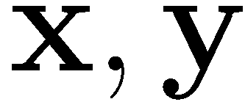
Operations on Vectors
Scalar multiplication
Addition/subtraction
Length
Normalized vector
Dot product
Cross product
are orthogonal if

Slide 9
Operations on Vectors
Scalar multiplication
Addition/subtraction
Length
Normalized vector
Dot product
Cross product

Slide 10
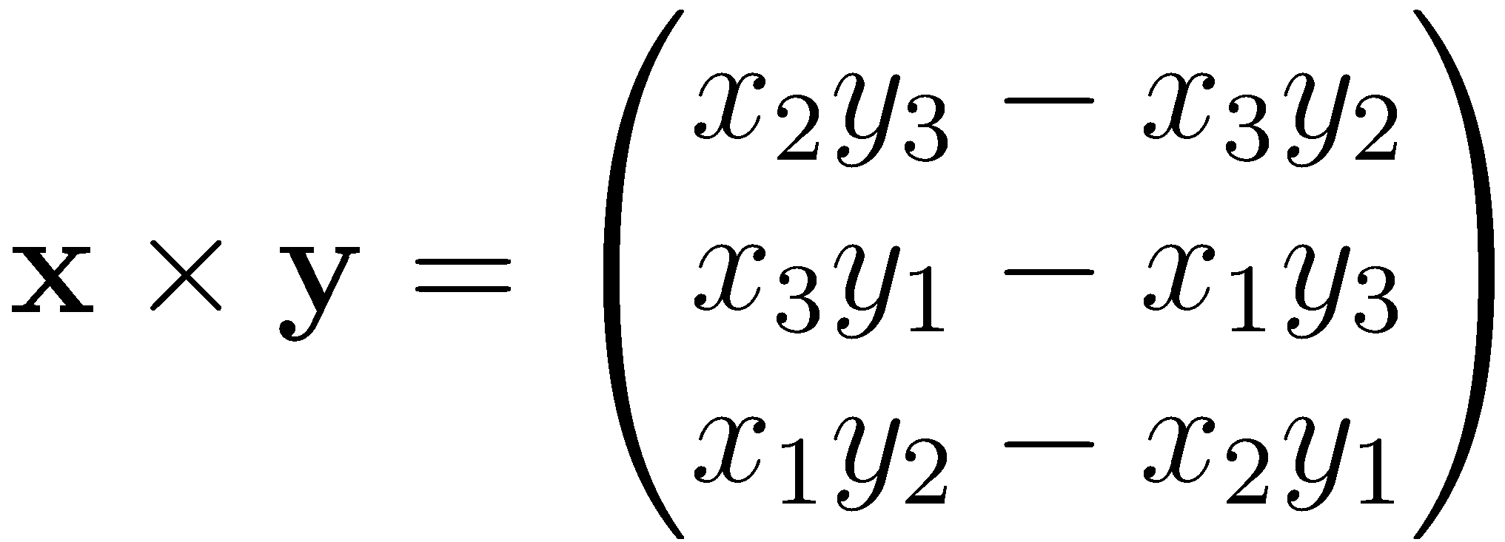
Cross Product
Definition
Matrix notation
Verify that

Slide 11
Matrices
Rectangular array of numbers
First index refers to row
Second index refers to column
rows columns

Slide 12
Types of Matrices
Square matrix
Diagonal matrix
Upper and lower diagonal matrix
Symmetric matrix
Skew-symmetric matrix
(Semi-)positive definite matrix
Orthogonal matrix

Slide 13
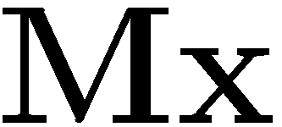
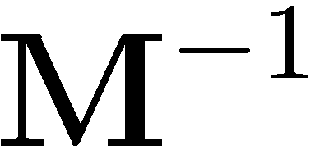
Operations on Matrices
Matrix-vector multiplication
Matrix-matrix multiplication
Inverse
Transpose
Singular value decomposition
Eigendecomposition (eigenvalues and eigenvectors)

Slide 14
Lessons Learned
Notation used in this course
Scalars, vectors, matrices
Most important operations
Next video: 2D and 3D geometry

