Slide 1
Autonomous Navigation for Flying Robots Lecture 1.1: Welcome
Jürgen Sturm
Technische Universität München

Slide 2
Course Goal
How can we enable a quadrocopter to fly autonomously?
How can we estimate its state from its sensor readings?
How can we generate control commands to move it towards its goal?

Slide 3
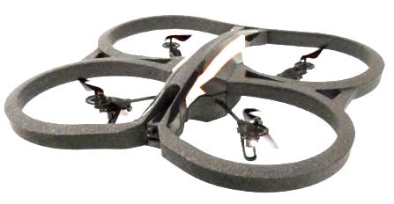
Control Architecture
Robot
Planner
Trajectory
Localization and Mapping
Position Control
Attitude Estimation
Attitude Control
RPM Estimation
Motor Speed Control
Sensors
Actuators
Position
Velocity
Acceleration
Physical World
Forces
Torques
Kinematics
Dynamics
Image Credit: Parrot

Slide 4
Course Content by Week
Introduction, state-of-the-art
Linear algebra, 2D geometry
3D geometry and sensors
Motors and motor controllers (PID)
Probabilistic state estimation
Bayes and Kalman filters
Visual odometry
Cutting edge research results

Slide 5
Course Organization
Course duration: 8 weeks
Video lectures
30-45 minutes per week
Interactive exercises
Quizzes, arithmetic problems
Hands-on programming exercises in Python

Slide 6
Upcoming Next
Lecture 1.2:
Why quadrotors?
Potential applications

